Slide 1
How do I access a vaccine?
Tracey Naledi
Deputy Dean: Health Services
Tracey.naledi@uct.ac.za

Slide 3
Prioritisation criteria for Phase 1 a
Age: if ≥ 45 years
Co-morbidity
Risk Exposure: Patient facing (> 50% of work day)
Clinical Setting: Critical care, Theatre, EC, COVID ward, PUI ward
Availability of vaccination slots for UCT

Slide 7
EVDS Website address
https://vaccine.enroll.health.gov.za/#/

Slide 8
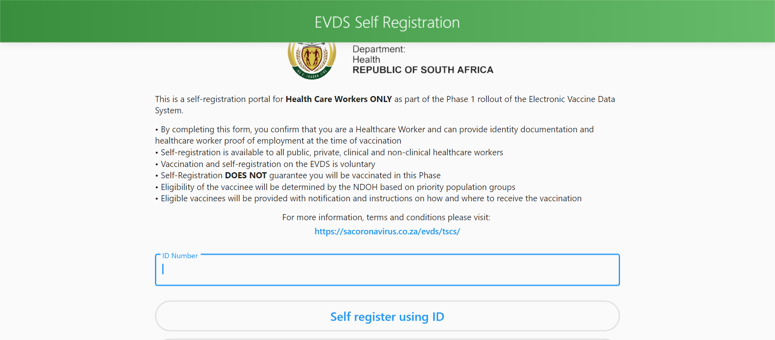

Slide 9
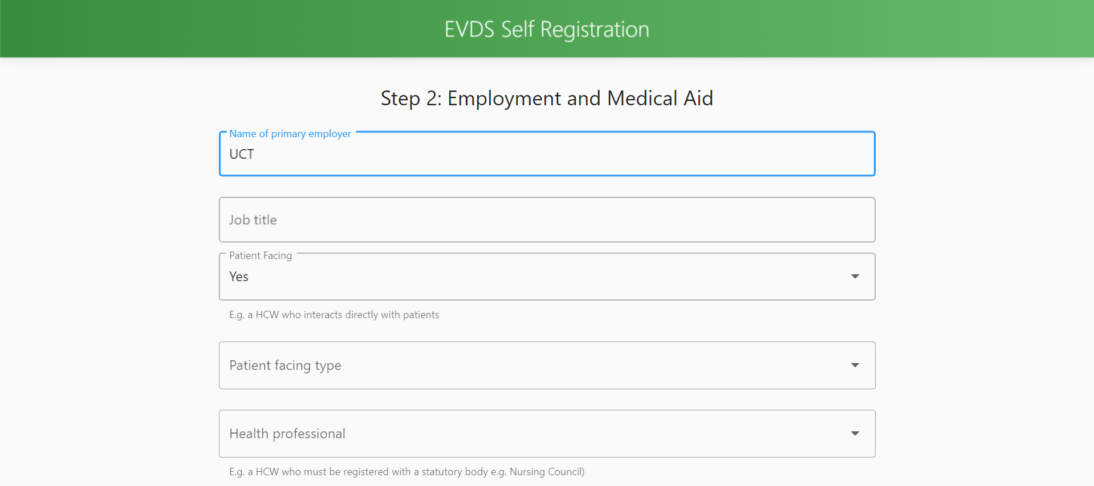

Slide 10
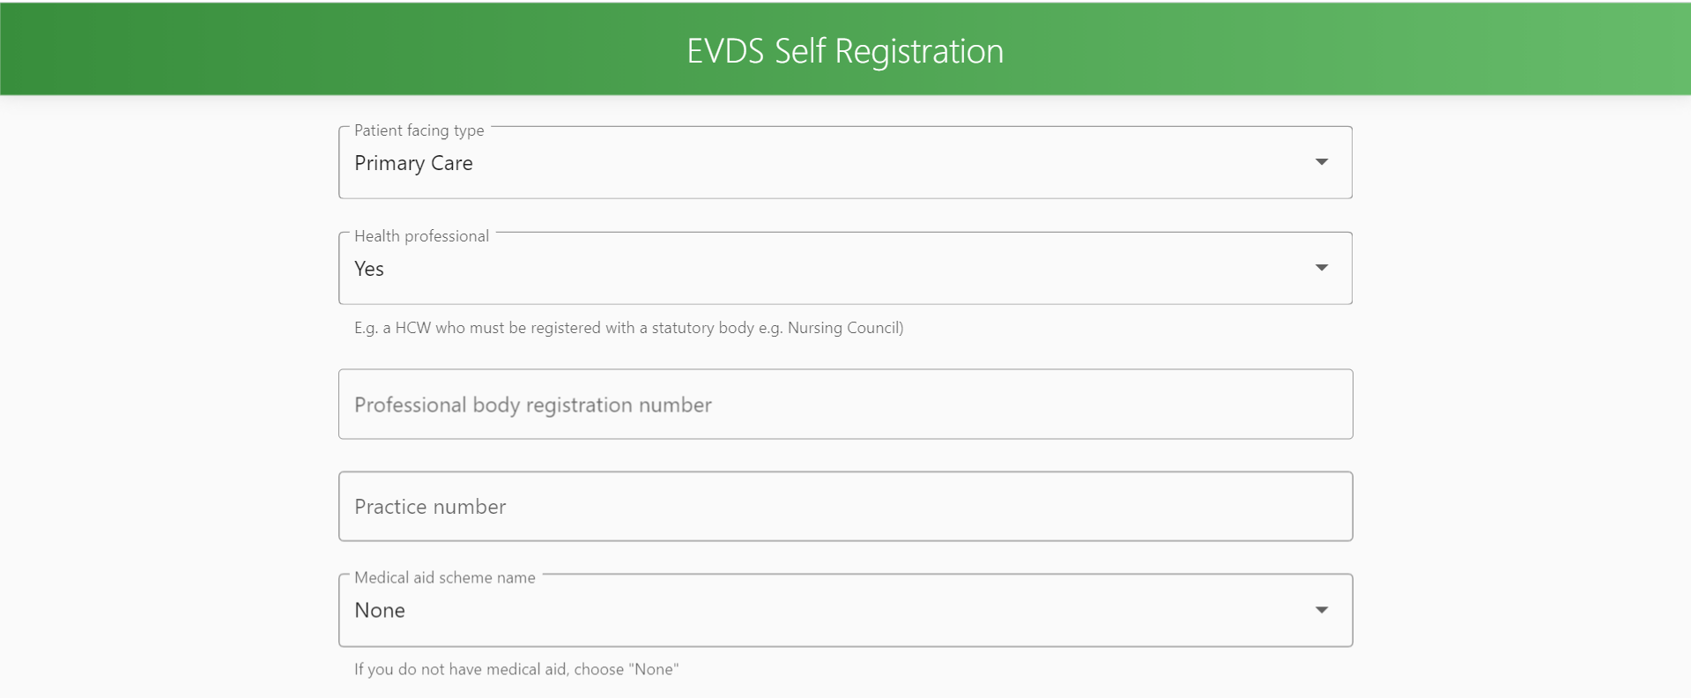

Slide 11
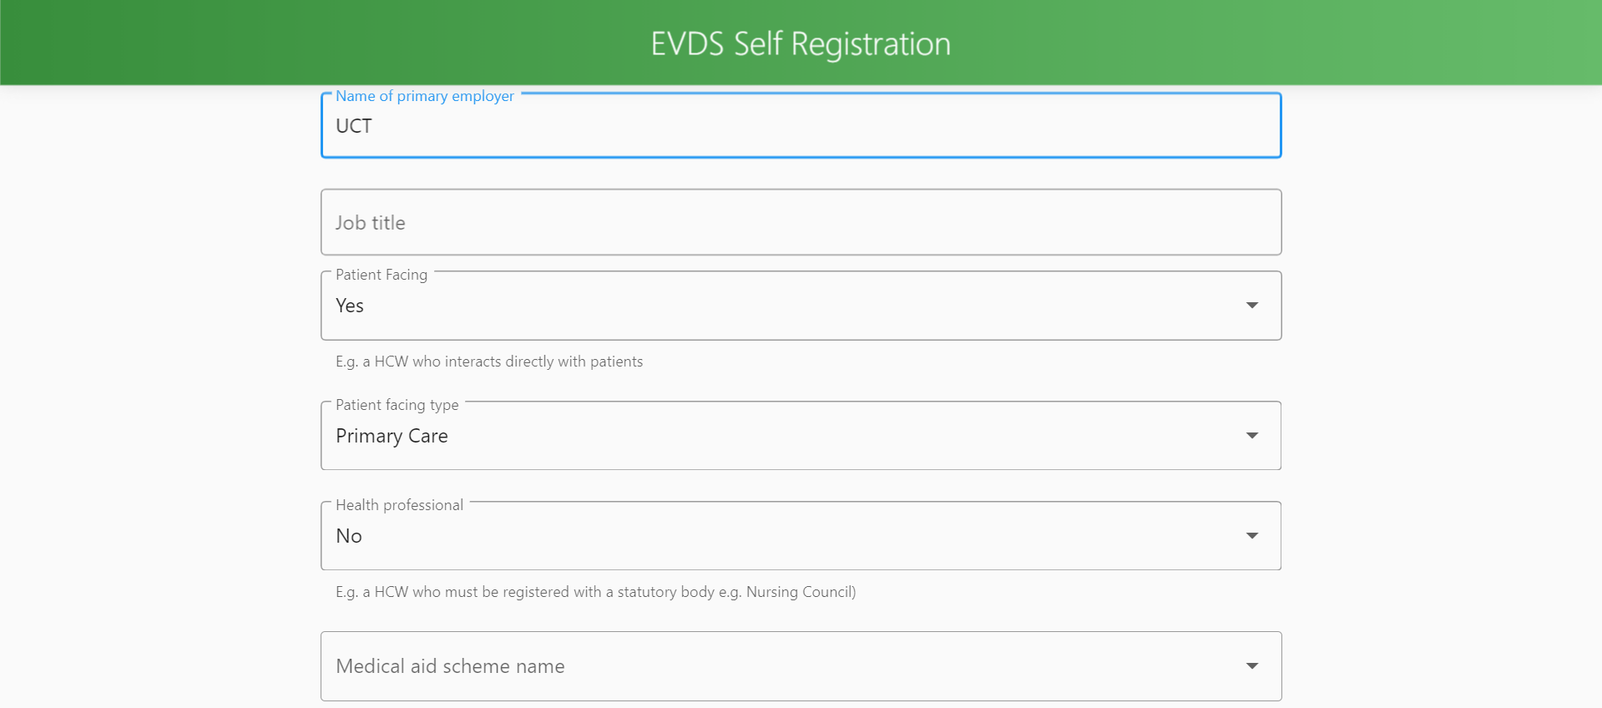

Slide 12
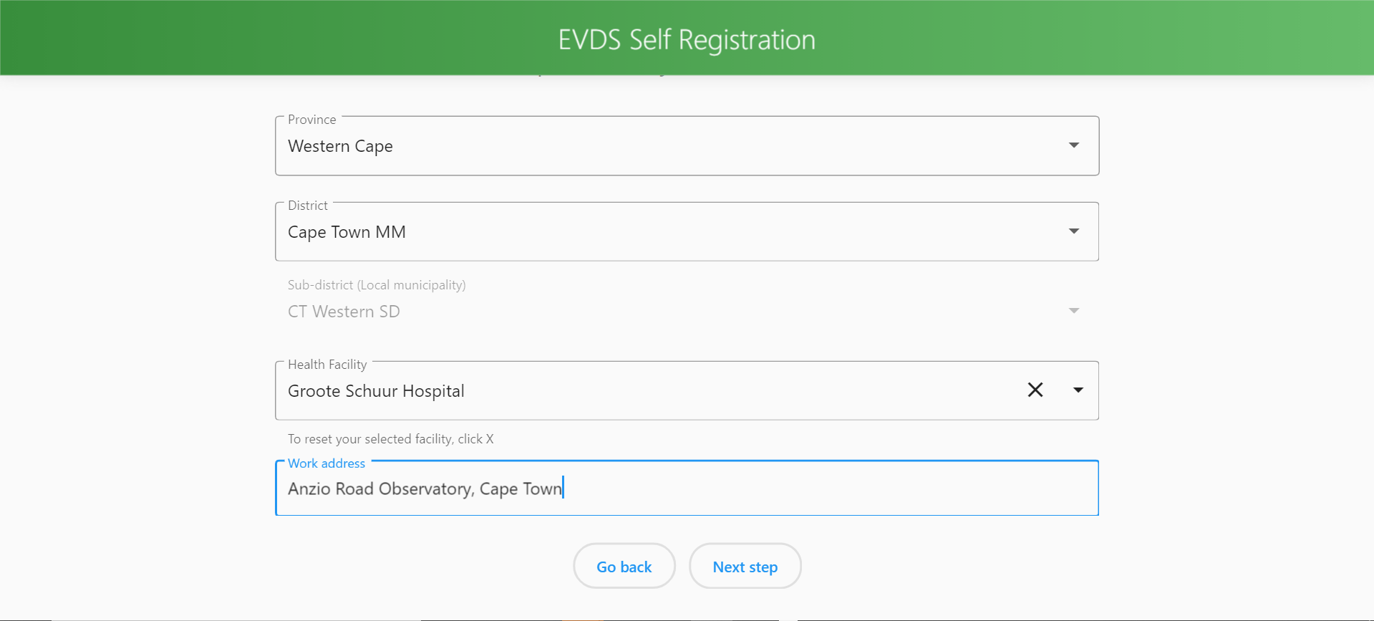

Slide 13
After registration on EVDS
SMS to confirm your registration
SMS to invite you to consent for Sisonke trial if eligible to receive a vaccine
https://sisonke.samrc.ac.za/#/

Slide 15
Accessing Vaccine
Currently based on a voucher system and booking according to priority criteria
Register on EVDS
https://vaccine.enroll.health.gov.za/#/
Consent on EVDS and in person post Sisonke.

Slide 16
I thank you

