Slide 1
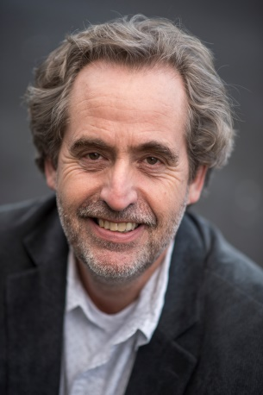
Supported Education for students with psychosocial disabilities
Lies Korevaar is Professor of Rehabilitation at the Hanze University of Applied Sciences in Groningen, the Netherlands, since June 2003. He is recognized as one of the pioneers in the field of Psychosocial Rehabilitation in the Netherlands and an international expert in the field of Supported Education for people with psychosocial disabilities.
He has been a consultant in Recovery Oriented Services in the Dutch Mental Health System for more than 15 years and he initiated the first university based Associated Degree for (ex)client s of Mental Health Services to become an Expert by Experience (Peer Support Provider) at the Hanze University.
Prof Korevaar’s relationship with South Africa began in 1996, when he was appointed as the designated trainer & consultant: Psychosocial Rehabilitation in a WHO-project in South Africa in the Western Cape and KwaZulu-Natal . For the period 2008 - 2012 he was an Honorary Associate Professor at the School of Nursing of the University of KwaZulu-Natal. Prof Korevaar has authored and co-authored numerous articles in professional and peer reviewed journals, two handbooks on Rehabilitation & Supported Education, book chapters and several rehabilitation training packages.
Before his appointment at the Hanze University Groningen, Prof Korevaar worked for almost 25 years as a clinical psychologist in the field of Mental Health, specializing in Psychiatric Rehabilitation and Supported Education. Among his many roles as a researcher, rehabilitation counsellor, trainer and consultant, Prof Korevaar was the principal investigator of the Erasmus+ ImpulSE project (2014-2017), a European Supported Education project for young people with psychosocial difficulties.
Lies Korevaar, PhD., Professor of Rehabilitation,
Hanze University of Applied Sciences ,
Research and Innovation Center for Rehabilitation, Groningen, the Netherlands.
The Department of Psychiatry and Mental Health and the FHS Mental Health Working Group cordially invites you to a presentation on Supported Education:
PRESENTER Prof Lies Korevaar
DATE 06 November 2018
TIME 12h30-13h30
VENUE Auditorium
Education Building
Valkenberg Hospital
Liesbeek Parkway, Observatory

Slide 2
About Supported Education…
Many students in higher education have psychosocial problems. They often meet with overwhelming obstacles, including stigmatization, social exclusion and discrimination. Research indicates that students with psychosocial problems spend more time on their education, but get lower grades and less study credits compared to their healthy peers (Broek et al., 2013). Students with psychosocial disability are at higher risk of early school leaving (Broek et al., 2013; ROA, 2014), reducing their chances of employment (Baum & Payea, 2013) and their broader social participation as citizens (Davidson, 2003).
Enhancing the functioning of students with psychosocial problems is a relevant starting point for reducing the percentage of school leavers and enhancing the capacity of the workforce in South Africa.
Educational and Mental Health professionals who want to support students with psychosocial disability to be successful and satisfied in educational situations often lack the knowledge and skills required to implement the comprehensive and individualised support interventions that are needed to help students fulfil their student role.
Supported Education is best known as a psychiatric rehabilitation intervention to help young people with psychosocial disability to pursue and achieve their educational goals.
The first Supported Education program in Rotterdam, The Netherlands was implemented in 1998.
The Research & Innovation Centre for Rehabilitation of the Hanze University Groningen developed a Supported Education Research & Innovation Program in 2004. The aim of this program is to develop and disseminate Supported Education information, services and products to help young people with psychosocial disability to start and/or to continue mainstream education.
In the presentation a brief introduction to Supported Education will be given and the challenges that students with psychosocial disability face to return to and/or remain at school will be discussed. Finally, the Supported Education intervention will be presented in more detail.

