Slide 1
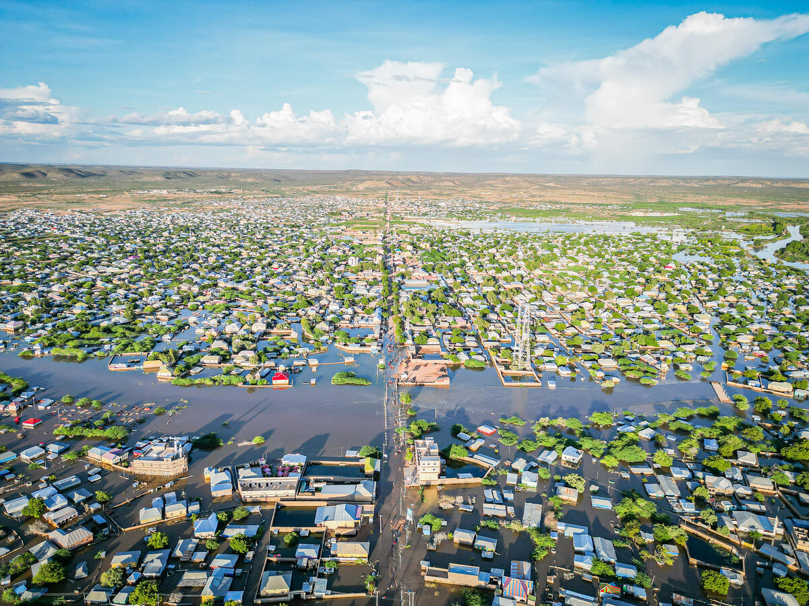
Recent public health emergency trends in Africa
Ayesha Kadir, Senior Humanitarian Health Advisor, Save the Children
Content Hub: CH1304412
Notes:
We have 20 minutes to talk about the trends in public health emergencies across the continent
I will break this down into trends related to drivers of public health emergencies
Review what this means for children, and how it impacts health service delivery
Photo: Southern areas of Somalia were hit by floods in May 2023, which affected almost half a million people. Nearly 219,00 people, including 118,000 children, were displaced by the floods. Also, flood water damaged basic infrastructure, home, agricultural land and basic services facilities.

Slide 2
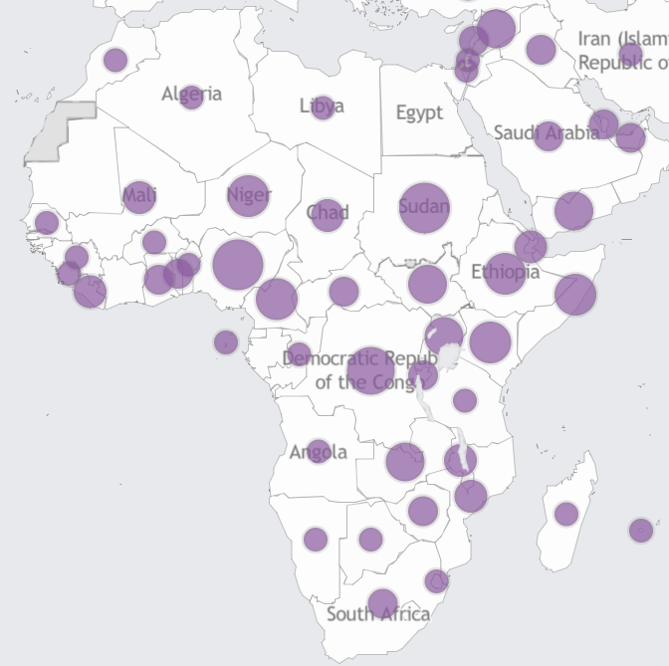
Public Health Emergencies overview (28 Sept 2023)
Source: WHO Health Emergencies programme

Slide 3
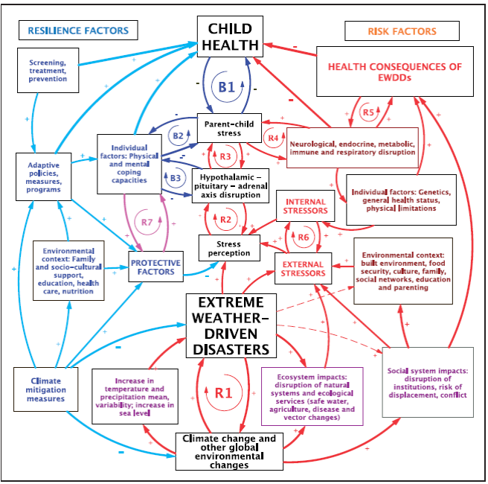
Impacts of public health emergencies on children
Armed conflict
Displacement
Climate change

Slide 4
Climate change
Climate crisis impacts getting worse
May be multiple displacements or moves
Many urban slum dwellers highly vulnerable to climate hazards
More children and families migrate in order to cope or just survive
Many migrate to urban areas seeking jobs and services
Children are from
‘other’ communities making inclusion and access to services difficult
Notes:
Climate change is manifesting in a range of ways,
extreme weather events like the droughts, and flooding
El Nino – expected to bring increased rains across the continent
Immediate and long-term changes, both of which are reflected by changes in behaviour and social arrangements

Slide 5
Collective violence
International
armed conflict
Social arrangements
structural violence economic violence
Subnational armed conflict
Community violence
Domestic violence
Interpersonal violence

Slide 6
Globally: A child survival crisis
>5 million children dying annually before fifth birthday from preventable and treatable causes
80% of these children were in Africa and Asia
12.7 million children across Africa were under-vaccinated in 2021, including 8.7 million “zero dose” children (UNICEF SOWC 2023)
Lack of routine catch up immunization schedules means many of these children are not able to access immunization outside of a campaign
12.2 million acutely malnourished children in Africa
Stunting prevalence 30.7%; global average 22%
Unknown prevalence of these stressors on child development trajectories → and life outcomes
Crises have pervasive impacts on child public health – don’t wait for a public health emergency to be declared
Locations - Humanitarian Data Exchange (humdata.org)

Slide 7
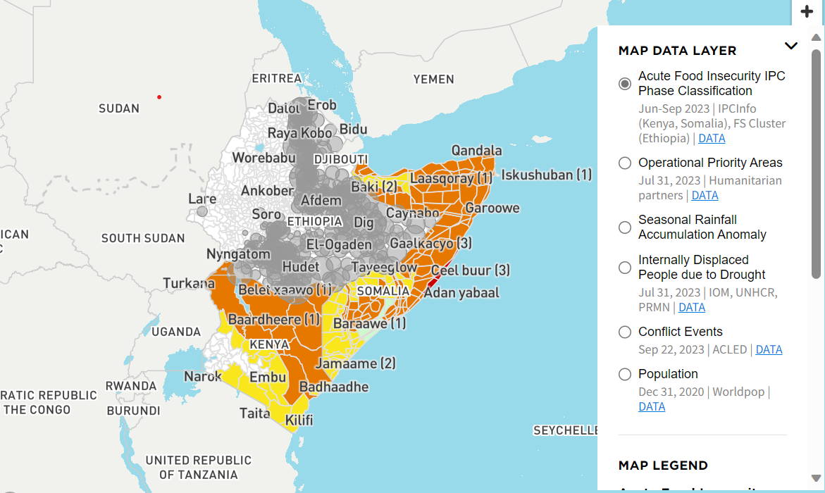
Greater Horn of Africa 2023
One of the worst droughts in recent decades
compounded by years of conflict and instability,
impact of the COVID-19 pandemic
rising food prices in part due to the war in Ukraine
Displacement – search for food, water, pasture for animals
Deteriorating hygiene and sanitation conditions
Low vaccination coverage
High rates of acute malnutrition and micronutrient deficiency
→ High risk of disease outbreaks
Current focus on measles, cholera, malaria, pneumonia and strengthening communicable disease surveillance and outbreak response
Horn of Africa Drought Data Explorer (humdata.org)
Notes:
Drought and food insecurity in the greater Horn of Africa (who.int)

Slide 8
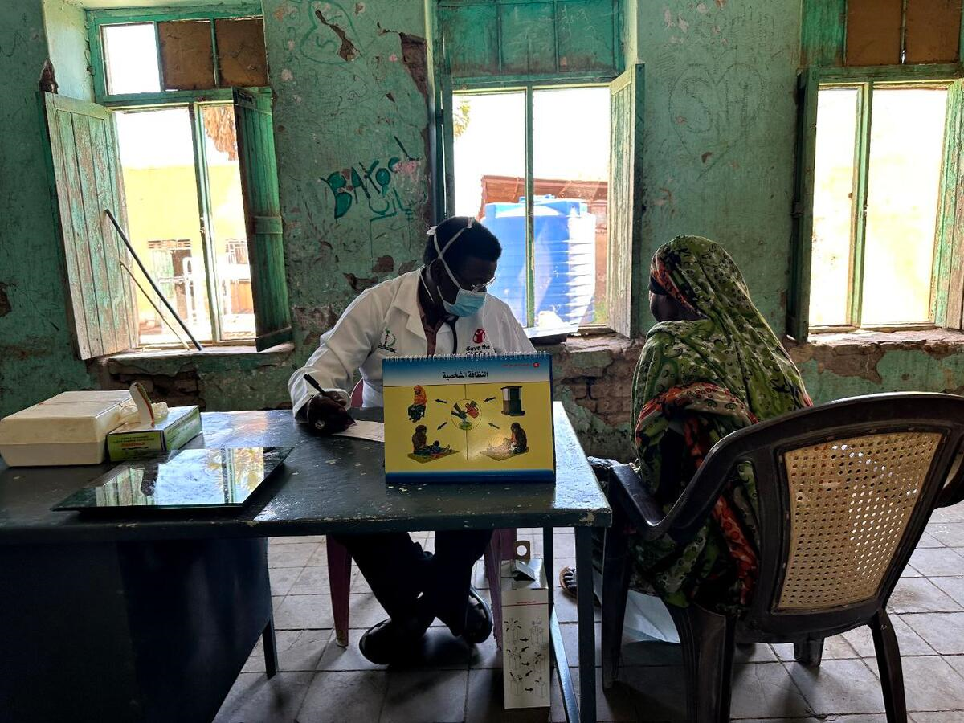
Snapshot of Sudan
April 15th conflict erupted
As of August 5.4m people displaced, including 2.2m children
Roughly 2.5 million people have fled to neighbouring countries: Chad, Egypt, South Sudan, CAR, Ethiopia and Libya. Includes refugees and returnees
Health workers and their families affected, many displaced
56 Attacks on health care since April
Shifting conflict lines driving further displacement – dynamic population movements
Humanitarian access severely impacted – Darfur health facilities not functional
Health services delivered through health facilities and mobile clinics
Needs assessments have identified priority areas for strengthening maternal newborn health and sexual reproductive health and immunization coverage

Slide 9
Reducing inequities in child health
Marked disparities in health and social outcomes between children on crisis-affected areas and children in stable, peaceful areas
Between countries and between settings within the same country
Protracted crises are increasingly common
Solutions must focus on maintaining routine preventive and treatment services in crisis contexts
Gaps in immunization coverage will require routine catch-up schedules to meaningfully improve immunization coverage

Slide 10
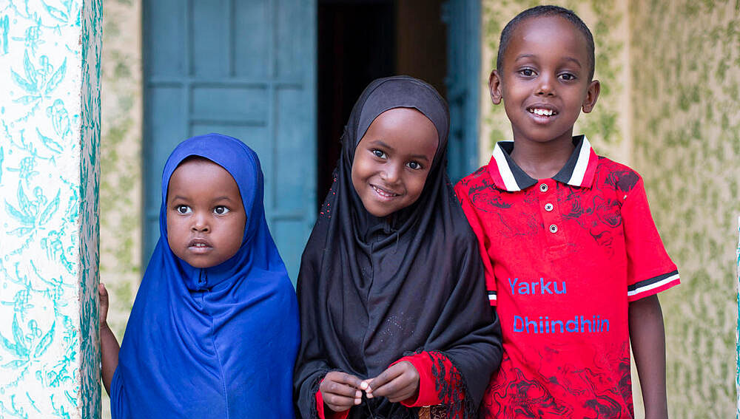
Thank you

