Slide 1
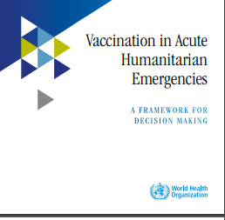
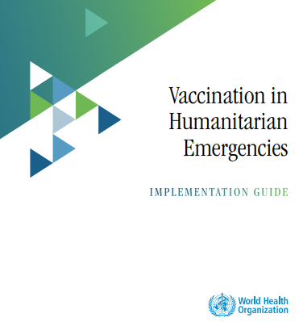
Challenges and opportunities in providing immunization services during emergencies, conflicts, and humanitarian context Vaccination in Emergencies
WHO Guidelines
Framework for decision making
Implementation guide

Slide 2
Outline
Background
Response Actions to be taken
Rational of task force establishment
Role & Terms of reference of the taskforce
Evidence based decision for use of vaccines in Emergency
Risk mapping and grading principles
Planning for Vaccination during emergencies & exit strategy
Strategies for Service delivery in Emergencies
Challenges and opportunities

Slide 3
Challenges
Opportunities
Lack of access to vaccination services in acute or protracted conflicts and humanitarian emergencies represents an important and growing reason for stagnating vaccination coverage.
Delivery of immunization services in such settings presents many challenges.
- NITAGs have increasing role in providing recommendations on vaccines and strategies used during emergency /Humanitarian response
This can be linked to the Incident management system that is established to coordinate emergencies where NITAGs input can be incorporated
NITAG advise is valuded as it is evidence based
NITAGs to anticipate request in updating the Immunization policy /technical guidelines on Immunization- on specific vaccine required during emergency
- Use of existing clusters on ground for service delivery (Food and nutrition distribution points brings efficiency
Why are seeing increased numbers of outbreaks
COVID-19 pandemic has set back the vaccination efforts
Decreased vaccination levels (measles, diphtheria, polio, meningitis, and yellow fever)
Insufficient coordination within the public and private sectors
Inadequate engagement of national immunization programs
Lack of surveillance and laboratory capacity, inability to link epidemiologic and laboratory data
Ecological, climatic and land-use changes (Cyclone, floods)

Slide 4
Background – Humanitarian Emergencies
Encompass crisis of short duration, long-standing crisis, and conflicts resulting in protracted humanitarian emergencies
Concept of “acute” emergency does not imply that the emergency in itself is short-lived,
Emergencies may lead to major & possibly continuous disruption of vaccination services provided through primary health care with resulting drop in vaccination coverage
Consequences --→ a decrease in population immunity,
Vaccination should be among the high-priority health interventions implemented to limit the avoidable morbidity and mortality of the VPDs
Maintaining or re-establishing routine vaccination services should be the primary objective of every national immunization programme.
Even in a protracted crisis, situations can emerge and be considered as “acute”, in particular when the conditions deteriorate, risk factors accrue, or the conditions evolve for a particular disease
In emergency situations, people, especially children and women, are vulnerable to communicable disease outbreaks including VPD outbreaks.
Aggravating factors ;co-existing malnutrition, crowded living conditions, and inadequate sewage & sanitation.
Well-established programmes are likely to be more resilient in an emergency situation.
increased morbidity & mortality from VPDs with potential risks for outbreaks, which may be of large scale.; lower population immunity due to mass population movements.

Slide 5
Acute Emergency-Occurrence of one or more of the following conditions, due to any reason (natural and/or man-made)
1. Sudden unplanned displacement of a large proportion of the population away from the community of habitual residence and into any settlement
e.g. refugee or internally displaced persons’ camps, host community, urban areas, or uninhabited areas within the same country or across international borders
2. Direct exposure of the civilian, non-combatant population to new or exacerbated and sustained episodes of armed conflict resulting in risk factors including disrupted access to health care, disrupted water and sanitation, food insecurity, etc.
3. Impending or already occurred sudden deterioration of nutritional status, as evidenced by reliable food security and/or nutritional indicators, beyond and above known seasonal fluctuations or situations of chronic poor nutritional status and/or food insecurity
4. Natural or industrial disaster resulting in temporary homelessness, disruption to critical public services
e.g. health care, water and sanitation, food deliveries, etc.), increased risk of injury and/or exposure to adverse weather conditions, famine, drought, environmental degradation for a large proportion of the population.
5. Sudden breakdown of critical administrative and management functions within the public and/ or private sector, due to any reason, resulting in large-scale disruption of public health and related services (e.g. water and sanitation)

Slide 6
ACTIONS (1) Establish a Task force (immunization task force /ITF Or equivalent to take right action at right time)
In humanitarian emergencies, it is important to clearly identify and appoint the team to lead and coordinate immunization activities
Immunization Task Force (ITF) should be established by the highest level of the health authority or by the humanitarian country team if a functional government does not exist.
An ITF may be established in the country based on existing bodies to avoid creating parallel systems, or can be established de novo, according to needs.
An ITF consists of government and/or local authorities and partners such as national and international NGOs, international organizations and civil society organizations (CSOs), and can be a part of the overall Health Task Force or Health Cluster , if a cluster approach is adopted within the country
The host country government and/ or local authorities have the primary responsibility for directing and coordinating the operational response of the ITF, with the strong support of other stakeholders whenever possible.
One of the main strengths of the ITF should be the mechanism for evidence-based decision making that all members adopt, advocate and apply. Ideally, emergency scenarios have been anticipated and prepared for, which would allow for the rapid convening of the ITF when a crisis strikes

Slide 7
Immunization Task Force (ITF) Role & functionality guided by Terms Of Reference
OPERATION CONTROL ROOM SHOULD ENSURE COORDINATION OF ACTIVITIES, COMMUNICATIONS, AND ONGOING RESPONSE TO THE NEEDS IN THE PERIPHERY
Representation of all levels of administration
Participation of strong national technical entity
Functionality of the task force needs these elements to be considered for its successful operationalization
NITAGs are missed out usually
IMMUNIZATION TASK FORCE AND HEALTH CLUSTER INTERACTION ENSURES ALIGNMENT OF INTERNATIONAL RESPONSES WITH NATIONAL STRUCTURES
ITF NATIONAL-LEVEL FOCUS:
POLICY ISSUES & STRATEGIC PLANNING ;Subnational focus LOCAL PLANNING & IMPLEMENTATION
ITF and NITAG should work together on technical issues
Early involvement of the community in all aspects of the Immunization work for its sustained implementation

Slide 8
Actions (2) Decision on use of vaccines in humanitarian emergencies – evidence based
THE IMMUNIZATION TASK FORCE SHOULD ASSESS THE NATIONAL IMMUNIZATION PROGRAMME
TO HELP DETERMINE
WHEN COMPREHENSIVE ASSESSMENT IS NOT FEASIBLE,
PRIORITIZE ASSESSMENT OF THE OPERATIONAL REQUIREMENTS.
Disease characteristics: recent and ongoing outbreaks of VPDs, seasonality of epidemic prone diseases (e.g. measles, cholera, meningitis, etc.).
Target/beneficiary population and service delivery characteristics (for routine or supplementary vaccinations): age groups, gender, geographic location, population movements, appropriate and equitable delivery strategies (i.e. fixed sites or outreach), baseline immunization coverage in the affected areas considering available data from different sources such as recent micro-plans.
Material resources: health facility infrastructure and functionality, vaccine and supplies availability, cold-chain inventory and current cold-chain capacity (to include information on possibility to resource equipment from other sources such as military, food industry, etc.), information on power supply (electricity, gas, solar, etc.), information on waste management practices (including availability of incinerators from health and non-health sector
WHAT EMERGENCY VACCINES TO DEPLOY,
THE SPECIFIC TARGET POPULATIONS AND THE RELEVANT GEOGRAPHIC LOCATIONS.

Slide 9
Framework for decision making (I) Risk grading of Vaccine Preventable diseases assessed in identified Province/districts

Slide 10
Worksheet for determining presence of key general risk factors (e.g.)

Slide 11
Relevance of each general risk factor for each VPDs

Slide 12
What are the Specific factors to be assessed for each VPDs

Slide 13
Algorithm for qualitatively synthesizing VPD-specific worksheets into an overall grading of specific risk, for any VPD

Slide 14
What are the Vaccination implementation consideration and Key questions ? (II)
Evidence based

Slide 15
Decision on use of vaccines in humanitarian emergencies
1) Logistics capabilities:
estimate of resources for efficient cost-effective flow of vaccines, materials & personnel to the target/beneficiary population (including transportation, shipping, storage, inventory management, cold-chain logistics, physical security, lodging, personnel security etc..
2) Human resources:
mapping & availability trained health care personnel, volunteers, private service providers, community based organizations & international partners
Malawi has Health facility mapping conducted with HR (unicef 2018?)
3)Financial resources:
estimate of funds needed & funds available for the intervention with regard to annual forecast, availability of donor funding
4) Social context
information on demand & acceptance of vaccination, identification of possible communication channels that could facilitate access and acceptance (local religious, opinion leaders, traditional healers, others).
5) Local challenges
Local government processes (e.g. customs procedures), partner collaboration processes, physical and personnel security
Integration
(MAXIMIZE INTEGRATION OF VACCINATION SERVICE DELIVERY WITH OTHER SERVICES

Slide 16
(3) Components of the emergency response Vaccination plan in humanitarian settings
Micro-plan (list & map, calculate, budget- comprehensive operational plan )
Vaccine supply, cold chain & logistics (bundling of supplies)
Demand related
(Behavior social drivers, local leaders, including community based interventions )
Specific strategies (tailor made for target population ; accessibility to guide strategies, quick in & out, transient points, staggered vaccination, mobile teams, campaigns in parallel to RI, PIRI )
Monitoring, Evaluation and supportive supervision (Simplified data flow, innovations for real time data transfer for prompt action )
Exit strategy for recovery of Routine Immunization (Shift from crisis to rehab, transition, updating the National Immunization strategic plan )

Slide 17
Suggested strategies for service delivery for specific contexts during different emergency situations

Slide 18
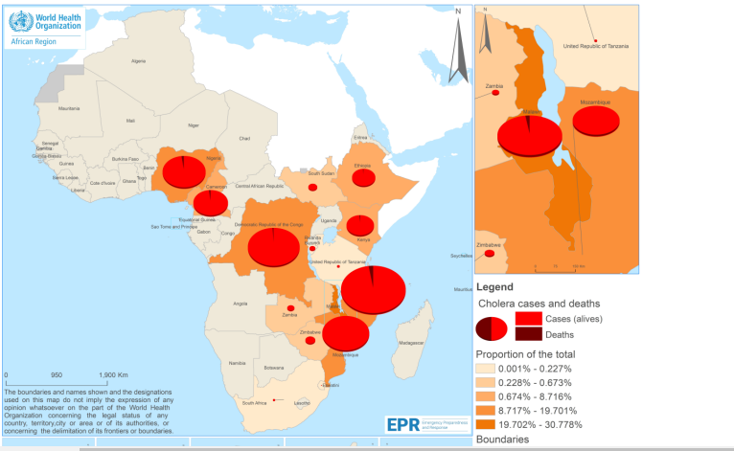
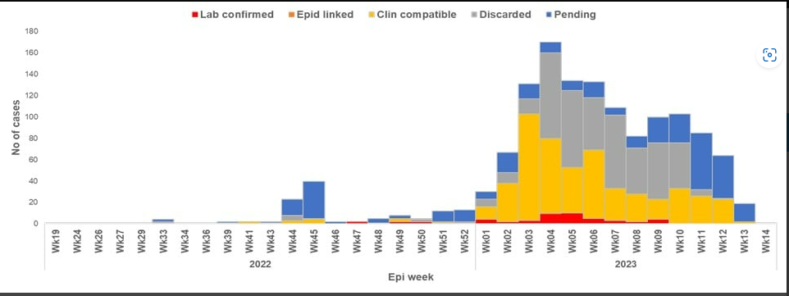
Observed situations in the region – set back in Immunization + emergencies related
Epidemic curve of diphtheria cases by year/epi-week in Nigeria, epi-week 19 2022 – epi-week 14 2023
Strategies to curtail the outbreaks of Cholera.
Enhancing readiness, heightening surveillance, scaling up health education, and strengthening cross-border coordination
Support for reactive and preventative oral cholera vaccine (OCV) campaigns in affected/endemic countries
Due to supply limitations ICG suspended the standard 2-dose vaccination regimen in favour of a 1-dose approach
1 dose provides protection up to 6 months
Single dose effectiveness in individuals ≥ 1 years old was:
40% against all cholera episodes ;63% against severely dehydrating cholera episodes
Countries should try submit ICG requests timely after outbreak confirmation with localities targeted for reactive vaccination
Preventive OCV Campaign (2 dose) application window now open
From 14 May 2022 - 9 April 2023, 1439, suspected diphtheria cases were reported from 21 states;
557 (39%) were confirmed cases, 73 deaths (CFR: 13%).
3rd dose pentavalent vaccine coverage estimated to be 57% (Nigeria MICS 2021); Public health response -vaccination of high-risk populations such as children under five years of age, schoolchildren, close contact of diphtheria cases, and healthcare workers

Slide 19
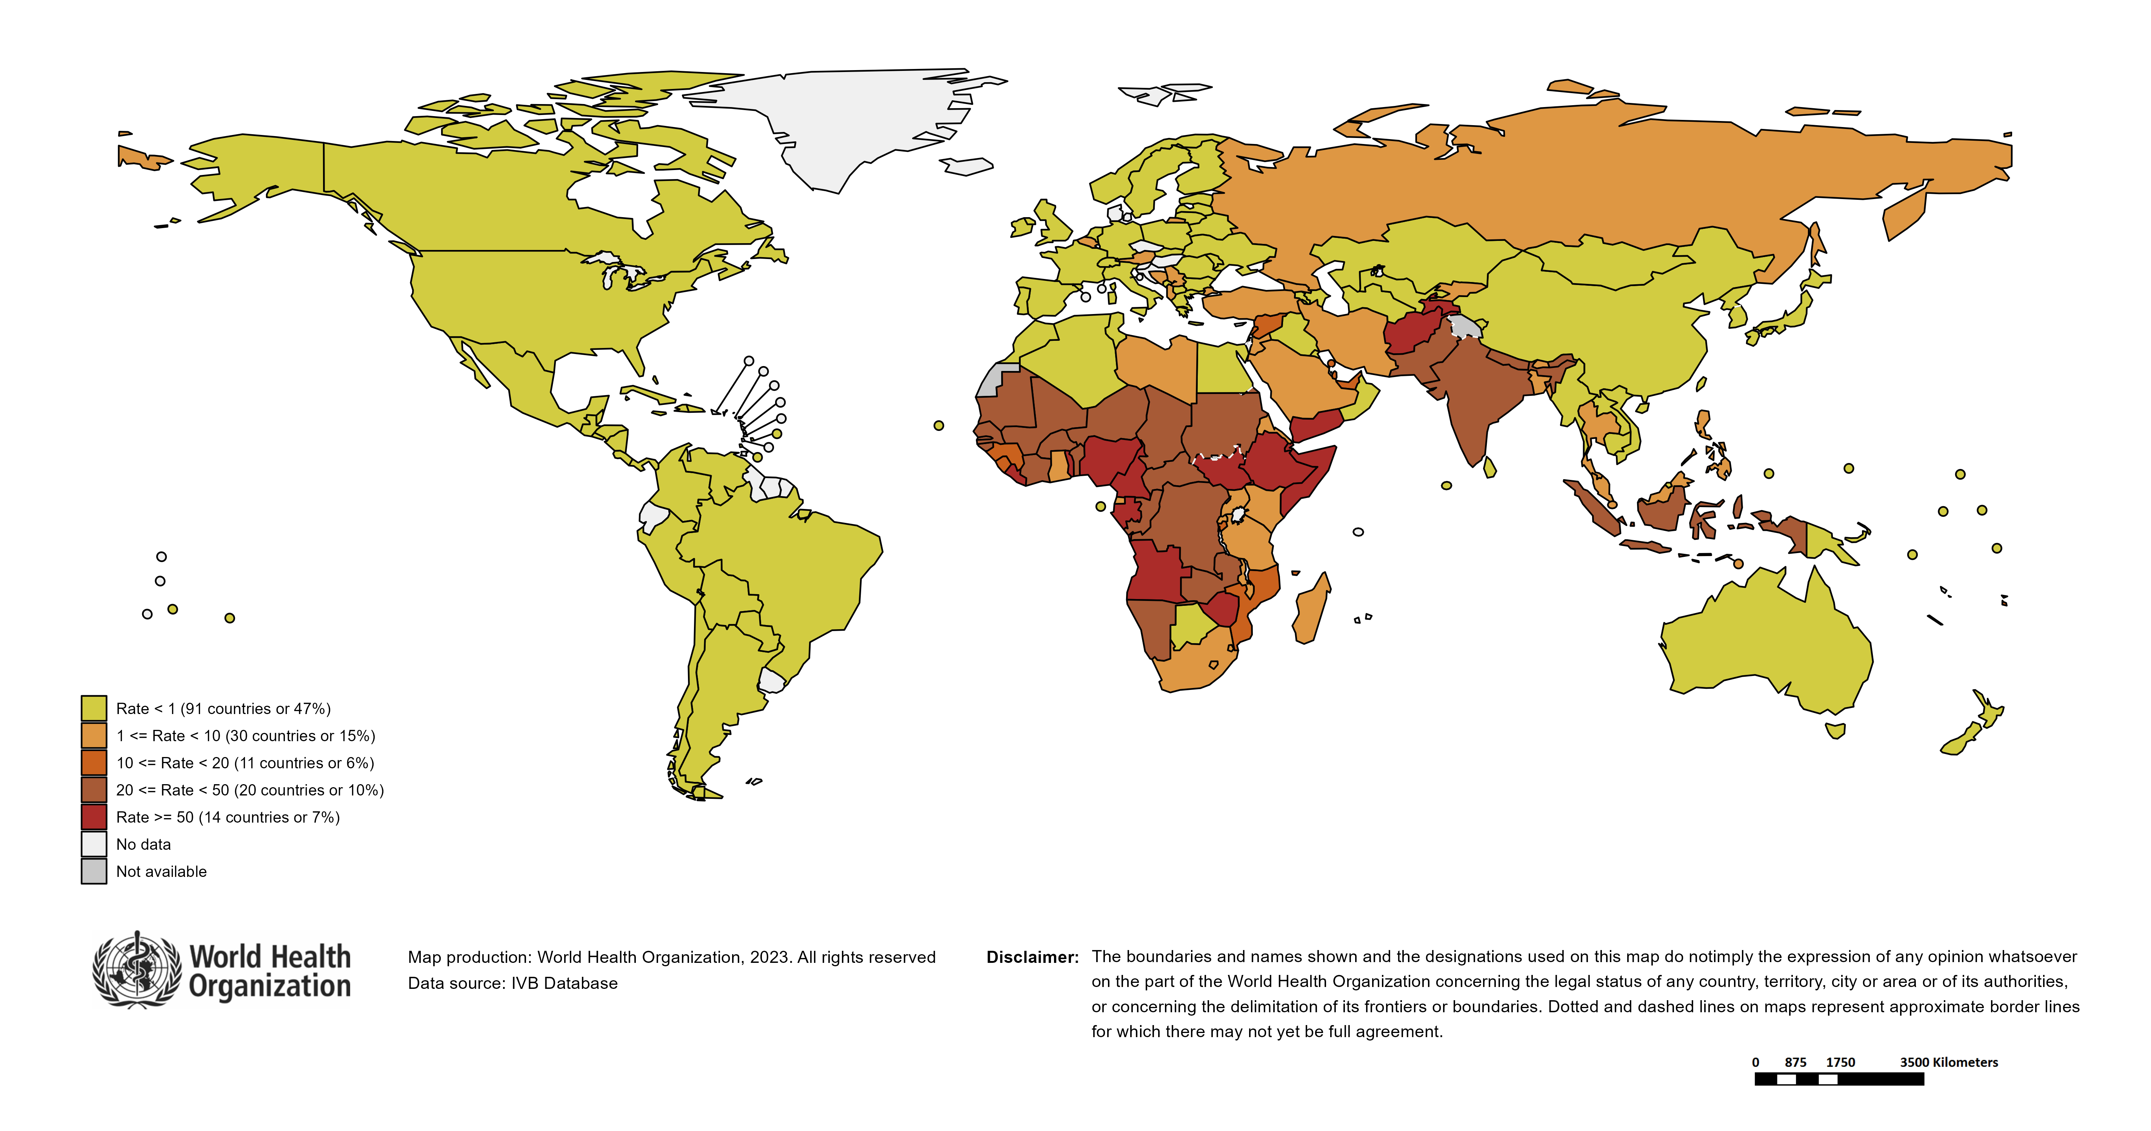
Measles Incidence Rate per Million, Large and Disruptive
Measles Outbreak (12M period) 3/2022 – 2/2023
Country | Cases | Rate/M
Liberia | 4,830 | 911
Gabon | 1,957 | 819
Somalia | 13,852 | 787
Yemen | 19,753 | 586
Zimbabwe | 5,127 | 314
Djibouti | 191 | 170
South Sudan | 1,614 | 148
Cameroon | 3,576 | 128
Afghanistan | 4,670 | 114
Angola | 3,346 | 94
Togo | 741 | 84
Ethiopia | 8,158 | 66
Tajikistan | 610 | 61
Nigeria | 11,081 | 51
India | 70,195 | 50
Guinea-Bissau | 103 | 49
Congo | 264 | 44
DR Congo | 4,289 | 43
Gambia | 109 | 40
Côte d'Ivoire | 1,114 | 40
Senegal | 669 | 39
Mali | 821 | 36
Pakistan | 8,439 | 36
Central African Republic | 199 | 36
Benin | 470 | 35
Chad | 621 | 35
Niger | 900 | 34
Burkina Faso | 767 | 34
Zambia | 662 | 33
Sudan | 1,536 | 33
Nepal | 786 | 26
Indonesia | 7,087 | 26
Namibia | 60 | 23
Mauritania | 95 | 20
Central African Republic
Chad
Burkina Faso
Afghanistan
Mauritania
Cameroon
Djibouti
Tajikistan
Nepal
Senegal
Mali
Pakistan
Niger
Sudan
Gambia
Yemen
Guinea-Bissau
India
Ethiopia
Indonesia
Liberia
Togo
Benin
Somalia
South Sudan
Côte d’Ivoire
Nigeria
Gabon
Angola
Zambia
Congo
Zimbabwe
DR Congo
Namibia
Notes: Based on data received 2023-02 - Surveillance data from 2022-03 to 2023-02 - Incidence: Number of cases / population * 1,000,000 - Population data: World population prospects, 2019 revision
Notes:
This slide overlays the large and disruptive measles outbreak with measles incidence rate per million for March 2022 to February 2023.
Despite the historically low number of measles cases reported over the last 36 months since the beginning of the COVID19 pandemic, measles has not gone away. Measles incidence rates remain concerning in 2022 with highest rates in sub-Saharan Africa – highlighting the risk that large immunity gaps pose.
The number countries with measles outbreaks characterized as “large and disruptive” has increased from 19 for the 12-month period from January – December 2021 to 34 in the 12-month period from March 2022 – February 2023 (~30% increase).
Responding to measles cases and outbreaks continues to be global priority.

Slide 20
Reflections
With increasing emergencies, outbreaks, humanitarian contexts in the region
NITAGs have increasing role in providing recommendations on vaccines and strategies used during emergency /humanitarian situations
What should be the plan for the affected Region or Province/districts (magnitude of the risk and potential threat –triangulate generated evidence )
Key actions – evidence guided (Risk assessment)
What strategy is to be used ?
Use of the Catch-up strategy guidance for operations (as addition)
How are we going to mobilse the resources including supply of the required vaccines ?
Opportunity of the Multi Stakeholder Dialogue with stakeholders
Existing partners with service delivery points (Food and nutrition cluster)
What timeline are we to respect ?
Emergency meetings similar to COVID to guide on some vaccines during emergencies not in schedule or for specific use anticipated
Vaccination during emergencies

Slide 21
Extra slides to detail the components of the plan

Slide 22
Integration of vaccination service delivery with other services
MAXIMIZE INTEGRATION OF VACCINATION SERVICE DELIVERY WITH OTHER SERVICES
INTEGRATION CAN INCLUDE USING ESTABLISHED CLINICS AND FOOD/ CASH DISTRIBUTION POINTS FOR VACCINATION OR USING UN TRANSPORT FOR DISTRIBUTION
THE NATIONAL-LEVEL MACROPLAN OUTLINES THE OPERATIONS AND BUDGET FOR VACCINATION DELIVERY
OBJECTIVES OF MICROPLANNING: COMPREHENSIVE OPERATIONAL PLAN DETAILED BUDGET WITH COMPLETE REQUIRED RESOURCES
PREPARE THE MICROPLAN EVEN IF THE CATCHMENT AREA IS INACCESSIBLE, AND ENVISION VARIOUS SCENARIOS OF ACCESSIBILITY.
WHENEVER POSSIBLE, INVOLVE THE COMMUNITY IN THE MICROPLANNING PROCESS.
OBJECTIVES OF MICROPLANNING: COMPREHENSIVE OPERATIONAL PLAN DETAILED BUDGET WITH COMPLETE REQUIRED RESOURCES

Slide 23
Microplanning Steps
1.List and map:
a. List all populated areas (e.g. villages, town, settlements) with estimated number of target population.
b. List all major transit points including information on population movement.
2. Calculate
3. Plan for vaccination teams & supervisors
a. Develop day maps for vaccination teams and supervisors with clear geographical demarcation.
b. Develop plan for deployment of vaccination teams at major transit points
c. Develop plan for mobile vaccination teams assigned for hard-to-reach areas and special population groups.
d. Develop plan for training of volunteers, vaccinators and supervisors, as necessary
c. Obtain maps of the area and chart distances, population density, population movements, landmarks, borders, seasonal characteristics (e.g. floods).
d. Identify and chart high-risk and hard-to-reach areas with population groups. e. Identify and chart border areas with population groups
a. Calculate the number of teams (vaccinators and volunteers) required based on location (i.e. urban, rural, nomadic, hard-to-reach) and vaccination strategy applied (i.e. permanent, temporary, mobile posts).
b. Calculate the number of supervisors required based on location of staff being supervised
(i.e. urban, rural).
c. Calculate requirements for vaccines and supplies, taking into account wastage rate.
d. Calculate requirements for cold chain and logistics (cold boxes, vaccine carriers, coolant-packs, tally sheets, reporting forms, social mobilization materials, transportation).

Slide 24
Micro-plan should address & budget Key components
4. Assign vaccinators and supervisors to teams and allocate the teams according to the plan developed
5. Develop logistics plan for distribution of vaccines, supplies and staff, including AEFI and management of waste
6. Develop social mobilization and communications plan, and plan for demand-related interventions (materials, staff, schedule and assigned area of responsibility, community engagement).
7. Develop reporting plan (timeline and person responsible).
8. Vaccine logistics movement plan (distribution and human resources)
• Monitoring and evaluation plan (including rapid convenience monitoring and/or coverage surveys, if at all possible) – to guide improvement in reaching the intended population

Slide 25
Vaccine supply
Vaccine supply
Humanitarian Emergency context
close collaboration among partners is essential to ensure uninterrupted availability of vaccines needed to sustain routine immunization or implement campaigns
Factors to be considered in vaccine supply during emergency
Funding and price of vaccines
Choice of vaccine product and procurement method
forecasting vaccine needs (quantities and timelines) and lead times required by manufacturers
Introduction of new or different vaccines in accordance with the country regulations
Customs procedures for import of vaccines and related materials
Timely supply of affordable vaccines of assured quality and safety is fundamental for immunization service delivery

Slide 26
Cold Chain
The emergency plan for the district and/or health facility level should ensure the following:
Readily available contact information of persons responsible for cold chain and logistics.
Readily available information on location and functionality status of the nearby cold storage and/or alternative storage spaces.
Adequate quantity of cold boxes and other passive containers (e.g. vaccine carriers) that can serve as temporary cold storage.
Readily available information on transportation means for transfer of vaccines.
Adequately trained staff for safe handling and transfer of vaccines to alternative locations.
Regular check of availability of identified alternatives and awareness of the responsible persons.

Slide 27
Logistics - ensure availability of adequate quantities of estimated Vaccine Supplies
Transportation of vaccines, related supplies and human resources should be well planned and should include
in-country distribution timelines with flexibility in transport options & routes should be considered.
The plan should be budgeted but no simple formula for estimation
1. Identify transportation needs (vaccines and related supplies/materials, vaccination teams and other personnel such as supervisors) and consider various means of transportation (vehicles, boats, aircrafts, rafts, animals).
2. Conduct an inventory of available transportation resources at all level

Slide 28
Logistics - ensure availability of adequate quantities of estimated Vaccine Supplies
3. Identify additional sources of transportation
4. Estimate fuel needs
5. Estimate costs of fuel and/or car rental if applicable
Whenever possible and/or necessary, transportation of vaccines and staff should be integrated with that of other supplies, e.g. transporting vaccines via convoys and integrated with delivery of other medical or lifesaving supplies.
based on average consumption per vehicle and estimated mileage per day.
Calculations of the fuel should take into account possible variations in fuel prices within a country or field conditions. Analysing historical meterological records of the country or region guides impact of severe weather on cost and capacity of transport system required at different time of the year

Slide 29
Demand-related and community-based interventions
INVOLVING COMMUNITY LEADERS INCREASES THE SUCCESS OF THE SOCIAL MOBILIZATION STRATEGY
ENGAGE COMMUNITY AND COORDINATE WITH PARTNERS TO CREATE DEMAND AND OPTIMIZE VACCINE UPTAKE
ENGAGE INFLUENTIAL LOCAL AUTHORITIES AND LEADERS TO OBTAIN COMMUNITY TRUST.
CLOSE COORDINATION WITH UNITED NATIONS DEPARTMENT OF SAFETY AND SECURITY IS CRITICAL TO IDENTIFY THE TIME FOR OPPORTUNISTIC VACCINATION EFFORTS
COMMUNITY ACCEPTANCE IS THE FOUNDATION FOR ALL ACCESS APPROACHES.
RESPECT INTERNATIONAL HUMAN RIGHTS AGREEMENTS AND INTERNATIONAL HUMANITARIAN LAWS.

Slide 30
Strategies for vaccine delivery – depending on the context
Strategy e
CONSIDERING ACCESSIBILITY, SECURITY SITUATION, VACCINATION PROGRAMME CRITICALITY AND LOCAL COMMUNITY CONTEX
Fixed sites and/or outreach (i.e. permanent and temporary fixed sites).
•Mobile teams from fixed facilities
Mass campaigns, including “multiple vaccines” campaigns
STRENGTHEN ROUTINE VACCINATION IN PARALLEL WITH THE CAMPAIGN
Periodic intensification of routine immunization (PIRI).; Initiatives with community involvement as well as compensation to the community when the community organizes vaccination sessions
Quick in-and-out operations, using windows of opportunity, such as temporary cease fires, to access the targeted area and conduct vaccination within a short timeline
Vaccination at transit points with frontline workers placed at the borders to vaccinate those exiting or entering hard-to-access and security compromised areas
Staggered approach ; Cross-border team strategies
Partnering with private for-profit health service providers to increase access to vaccination and basic package of health care services.; Collaboration with CSOs working in the area.

Slide 31
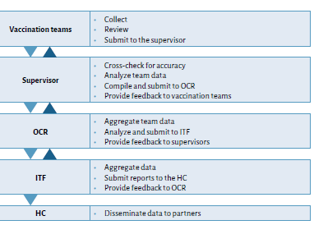
Monitoring , Evaluation supportive supervision use innovation ideas /technologies
THE METHOD USED TO REPORT ON VACCINATION ACTIVITIES AND DATA FLOW SHOULD BE THE SAME AS BEFORE THE EMERGENCY, OR SIMPLIFIED.
SIMPLE BUT SPECIFIC CORE MONITORING INDICATORS ARE RECOMMENDED.
Proposed flow of data

Slide 32
Suggested Indicators for different emergency situations

Slide 33
Exit strategy – Recovery of Immunization services
Transition
from implementation of vaccination under humanitarian emergency to implementation of regular routine immunization
may facilitate accountability and avoid donor fatigue
Shift from crisis to
rehabilitation
To rehabilitation of vaccination services and infrastructure should be considered only when the situation improves and a return to routine service delivery is possible
aim is to optimize the use of the resources which were made available during the emergency. The interventions conducted, experience gained or innovations applied during the emergency should be sustained and strengthened.
Updating
cMYP /National Immunization Strategic plan
Development or updating of a comprehensive multi-year plan may be useful for immunization programme recovery
In protracted emergency situations, and even in active conflicts, all attempts should be made to (re)establish routine vaccination services utilizing available and rehabilitated health facilities and the activities of all health care providing partners who can deliver vaccination on the ground
provision of routine vaccination should always be assured, not only at the stage of the exit strategy
The partnership and coordination which have been built during the crisis should be sustained and the integrated health service delivery should be expanded and strengthened
The proportion of vaccinations provided through each of the fixed, outreach and mobile delivery strategies will depend on available and rehabilitated infrastructures as well as feasibility of implementation.

