Slide 1
Conducting routine immunizations during public health emergencies: Experiences and lessons from E-NITAG
Liya Wassie (PhD)
E-NITAG core member
NITAG Support Hub (NISH) Vaccinology webinar series for NITAGs in Africa
04 October 2023
Notes:
NITAG=National Immunization Technical Advisory Group
NISH= NITAG Support Hub

Slide 2
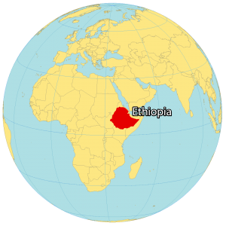
Ethiopia’s context
Ethiopia | 2000 | 2017 | 2023
Total population | 67,031,867 |  | 126,527,060 (11th)*
Urban | 9,807,289 (14.6%) |  | 27,959,894 (22.1%)
Females |  | 49.8%**
Fertility rate | 6.56 |  | 3.98
Median age (yrs) | 15.1 |  | 18.8
Children under 1 yr |  | 3.1%**
Children under 5 yrs |  | 14.6%**
Source: Worldometer (www.worldometers.info); *Global rank; **Health and Health related indicators; FMoH, 2016/2017
Notes:
Full immunization= DPT, Penta3, PCV-3, Measels

Slide 3
Ethiopia’s context
Immunization is one of the basic health services
395 hospitals
3,704 HC, 18,202 HP
> 21,000 HFs providing immunization services
Under 5 mortality rate declined from 123 in 2005 to 59 in 2019
Vaccines | General Immunization Coverage
 | 2017 | 2022
OPV3 | 68% | 64%
BCG | 73% | 68%
PCV3 | 64% | 61%
DPT3-HepB3-Hib3 (Pentavalent 3) | 65% | 68%
Measles1 | 59% | 56%
Measles2 | Not available | 48%
Rota | 67% | 65%
Source: EDHS 2000-Mini EDHS 2019
Source: WHO Immunization dashboard, WHO Immunization Data portal
Notes:
HC=health centers; HP= health posts; HF=health facilities
The figure is slightly higher based on reports from the MoH, Ethiopia

Slide 4
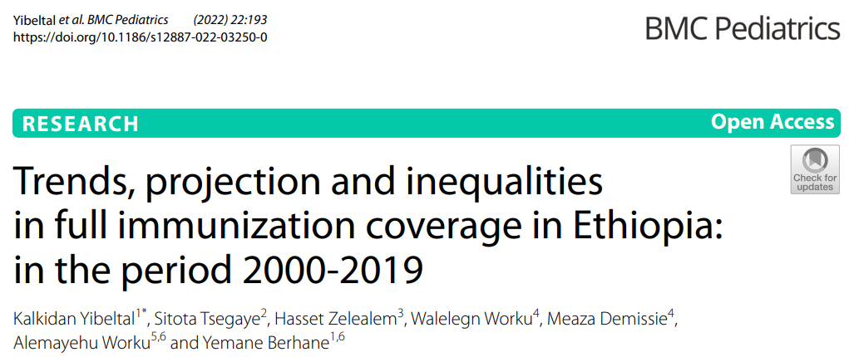
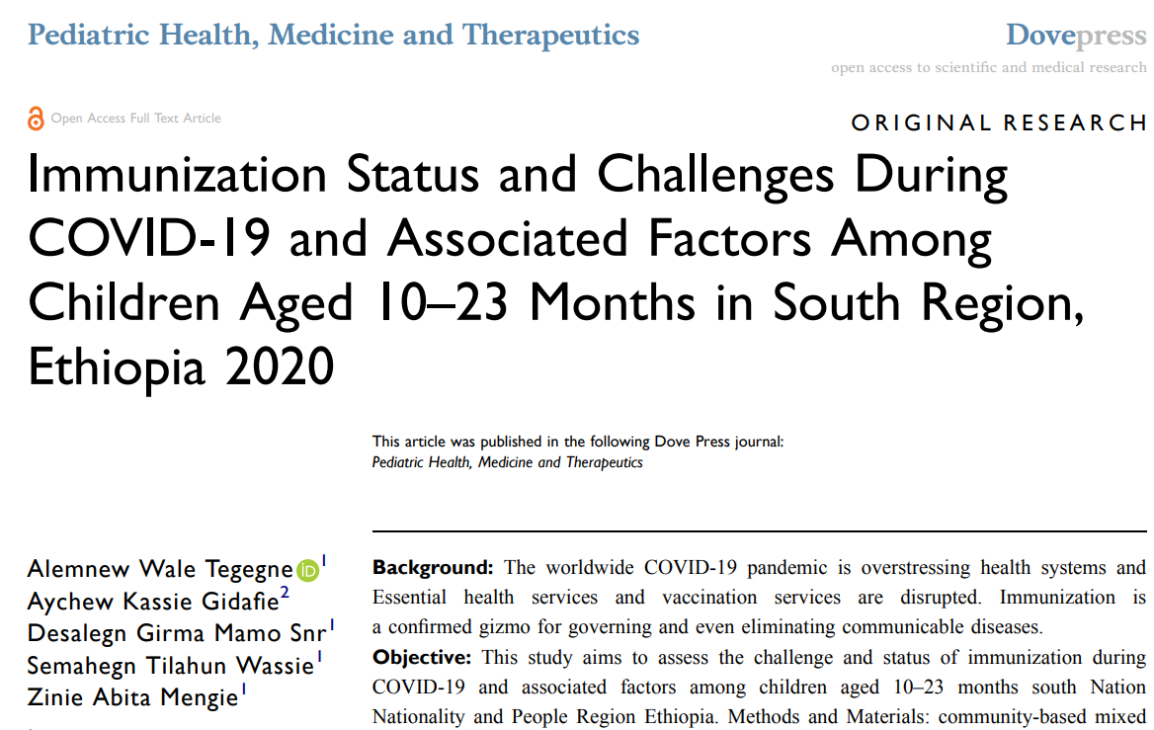
Immunization services during public health emergencies/ pandemic situation, conflict and humanitarian crisis
Challenges
Health service disruption, precluding routine immunization
most unit facilities and personnel diverted to curb the pandemic
62.2% incomplete immunization, despite facility delivery (~73%); 85% took BCG and OPV
Immunization dropouts: Penta1 (84%) to Penta3 (72%); PCV1 (84%) to PCV3 (74%)
Poor maternal health literacy and economy
Poor service-seeking condition (fear of COVID-19 during transportation)
Long waiting time at health facilities
Similar delivery places for COVID-19 screening/ immunization and other EPI vaccines

Slide 5
Other challenges for better immunization services
Access to proven/new vaccines
Expensive cost and financing needs
Global supply constraints
Hesitancies and resistance for new vaccines
Internal displacement and humanitarian crisis due to conflicts
Poor vaccination coverage in some settings (pastoralist and semi-pastoralist communities)
Catch-up vaccination strategies (for missed or interrupted doses) recently introduced
Infrastructure: lack of cold chain facilities
Weak surveillance system
Lack of data digitalization
Delays in reporting, data quality issues
Staff turn-over
Estimation of diseases burden
Poor regulatory frameworks in place to follow S/AE or PMS
Poor research landscape and lab infrastructure/capacity
Notes:
Catch-up vaccination strategies recently introduced (2020); Regulatory frameworks: IRBs, E-FDA; PMS=post marketing surveillance

Slide 6
E-NITAG’s role in the immunization services
Advise to introduce COVID-19 vaccines
Efforts to make routine immunization and continued measles vaccination campaigns as one of essential services during the ongoing pandemic
Advise to the MoH:
Vaccine delivery using chartered airplane
Use of mobile team
Service delivery through humanitarian organizations (IRC, WHO, UNICEF) and other local CSOs
Development of catch-up vaccination guide and implementation of integrated catch-up vaccination service in areas with intensive interruptions
Notes:
NITAG’s advisory role in the planning and implementation of the immunization practices during emergency situation
IRC= International Rescue Committee; CSO= Civil Society Organization

Slide 7
Opportunities for better immunization services
National/regional awakening for self sufficiency in vaccine manufactory
Political commitment
Support from Africa CDC, WHO and others in promoting local vaccine production
Capacity building and strengthening for lab infrastructure
Notes:
One of the problems during the COVID-19 pandemic was vaccine nationalism, which led to the awakening of poor countries for self sufficiency in vaccine manufactury…

