Slide 1
Funding options for early-stage researchers
Dr Yolande Harley
Health Sciences Director of Research
Fogarty HIV-associated Tuberculosis Training Programme: Health Sciences Students’ Symposium
22 October 2021

Slide 2
What could be your role?
Research roles:
  Principal investigator – research lead on study
  Co-investigator – active research role in study
  Contributor/consultant – important, but less central role (e.g. provision of expert advice, facilities, access to study participants/samples)
  Study personnel – employed to work on study
  Student/trainee – learning through work on study
Played out across many types of studies:
  Small, simple studies, e.g. one site, locally-relevant question
  Large, complex studies, e.g. multi-site, muti-institution, international with many questions/sub-analyses
  Investigator led, industry led

Slide 3
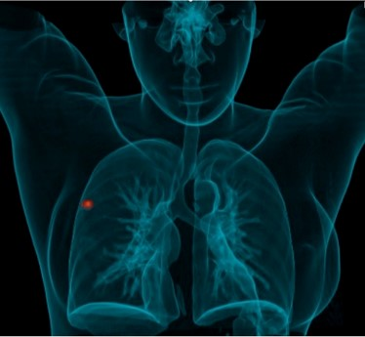

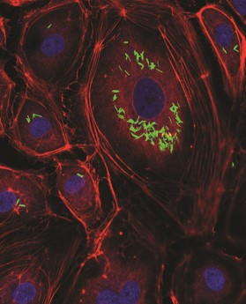
What could be your role?
Career roles for clinically qualified researchers
  Clinical academic
    Variable combination of clinical service, research, teaching/training
    Clinical research fellow
  Research medical officer
  Industry role
  Other (e.g. health/science council, NGO, PDP)
  Full time clinician contributing to research

Slide 4

Clinical research career pathways
Entry points and opportunities for training:
  Electives during medical training
  Intercalated undergrad/postgrad degrees
  Specialist training – Mmed research project
  Masters/PhD training full-time or while working
  Learn on job, e.g. as research medical officer

Slide 5

Health research: excellence, relevance & funding
Excellent globally, relevant locally
Awareness of landscape – find niche
Entrepreneurial approach to funding and collaboration
Scientific research relies heavily on ‘soft’ funding
There are insufficient institutionally-funded scientific posts for all who wish to be researchers (esp. research leaders)
Finding funding is an integral part of the role

Slide 6
Why apply for funding?
One of the main ways to fund the science you want to do
To train scientists
To develop infrastructural capacity
To build collaborations
Successfully obtaining grants improves your scientific CV
Ultimately, health research grants allow for important research to tackle the disease burden

Slide 7


Funding: ask yourself
What is needed to do the research?
Can you conduct it on your own?
Who should you work with?
What are the relevant funding schemes?
What is the contemporary funding situation like?

Slide 8

Types of grants
Fellowships / investigator grants
Seed grants
Project grants
Programme grants
Training grants
Travel / meeting grants
Public engagement grants
Infrastructure grants
Technology development grants

Slide 9
Funders
Institutional
Government, local/foreign
  Country specific differences
Charitable and NGOs (foundations, trusts)
Industry
Partnership initiatives

Slide 10
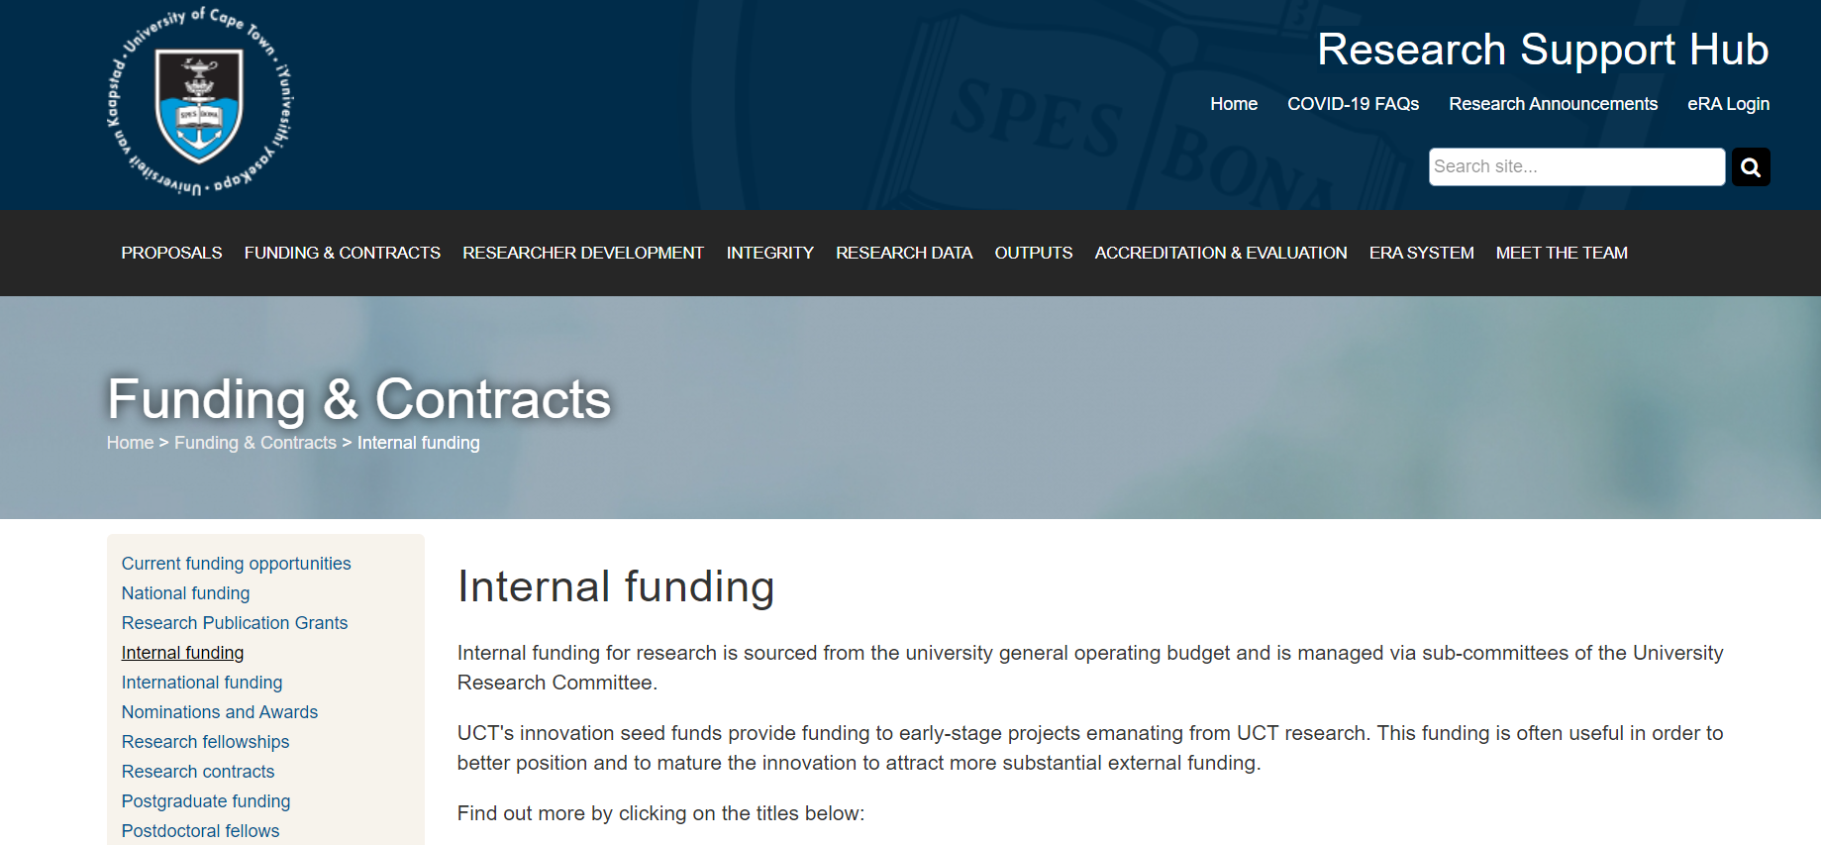

Institutional
Institutions may use internal funds or may manage funds in donor’s name

Slide 11
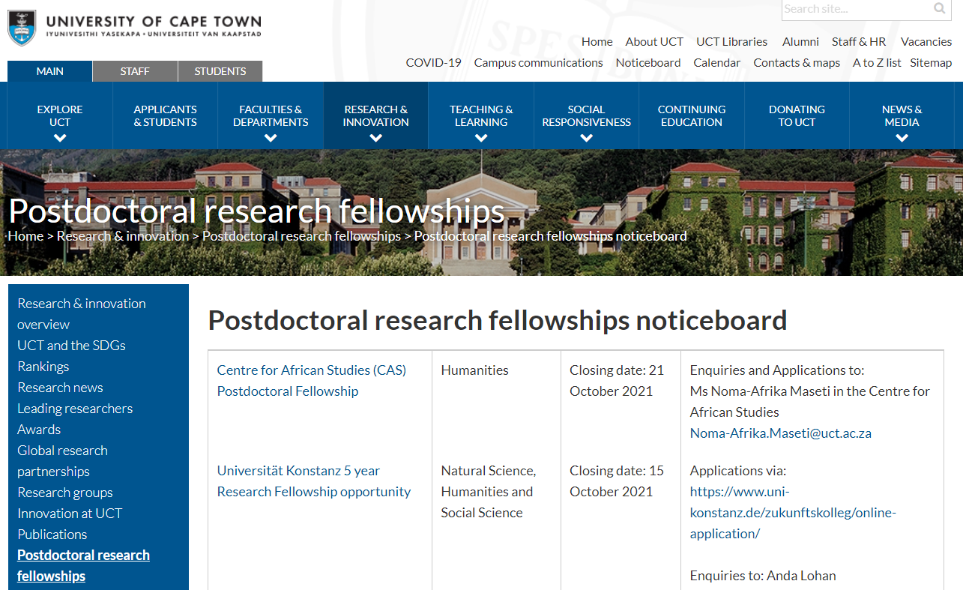
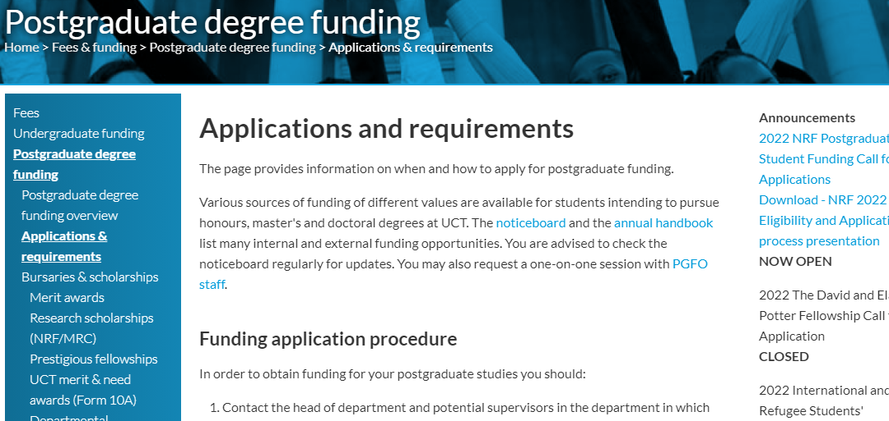
Institutional
Postdoctoral & PhD funding available through UCT
Notes:
.

Slide 12
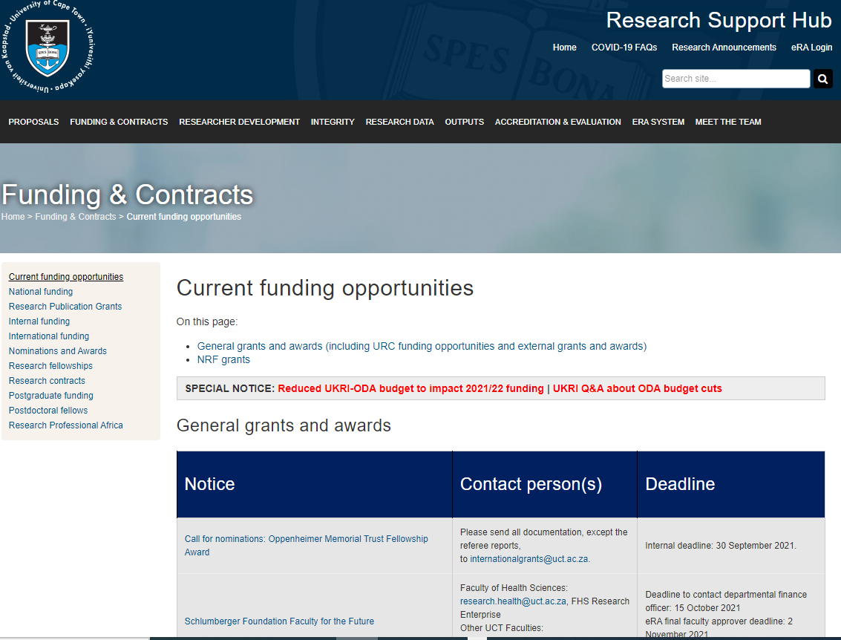
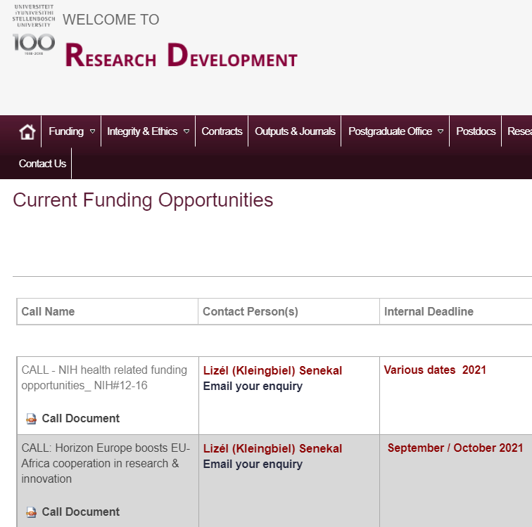
Institutional (and beyond)
http://www.researchsupport.uct.ac.za/current-funding-opportunities
www.sun.ac.za/english/research-innovation/Research-Development/Pages/Open-Calls.aspx

Slide 13
National funding
SA National Research Foundation (NRF)
  www.nrf.ac.za/funding
  www.nrf.ac.za/bursaries/calls
SA Medical Research Council (SAMRC)
  www.mrc.ac.za/funding/rfa.htm
  www.mrc.ac.za/researchdevelopment/opportunity.htm
Cancer Association of South Africa (CANSA)
  www.cansa.org.za/category/recent-posts/cancer-research/research-funding-and-grants/
Poliomyelitis Research Foundation (PRF)
  www.prf.ac.za/how-to-apply/grant-information/
Technology Innovation Agency (TIA)
  www.tia.org.za/funding

Slide 14
International funding…
National Institutes of Health (NIH); and Fogarty
  www.nih.gov/grants-funding
  www.fic.nih.gov/FUNDING/pages/fogarty-funding-opps.aspx
Wellcome
  wellcome.ac.uk/funding
Bill & Melinda Gates Foundation
  gcgh.grandchallenges.org/grant-opportunities
Newton Fund
  www.newtonfund.ac.uk/funding/funding-opportunities/
UK MRC
  www.mrc.ac.uk/
European Commission research & innovation, and European & Developing Countries in Clinical Trials Partnership (EDCTP)
  ec.europa.eu/research/participants/portal/desktop/en/home.html
  www.edctp.org/funding-opportunities/calls/
TDR
  www.who.int/tdr/grants/en/

Slide 15
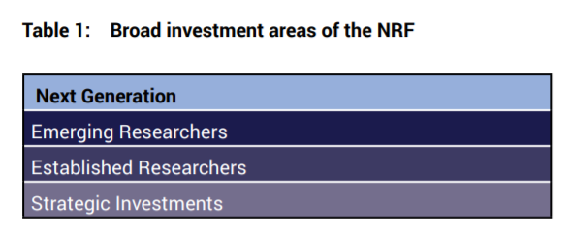
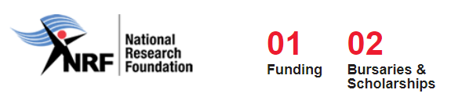
National Research Foundation
Broad investment areas
  Next generation
  Emerging researchers
  Established researchers
  Strategic investments
https://www.nrf.ac.za/

Slide 16
SA Medical Research Council
Some annual calls, e.g.
  SAMRC Self-initiated Research Grants
  National and International Conferences
Some irregular, e.g.
  SAMRC Extramural Research Units
  Strategic Health Innovation Partnerships (SHIP)
Scholarships and Grants
Notes:
SAMRC Extramural Research Units
Might be targeted at specific potential principal investigators, e.g. women, or in specific fields, e.g. antimicrobial resistance.
Can fund early-career researchers through these unit budgets, such as Student bursaries, scholarships.

Slide 17
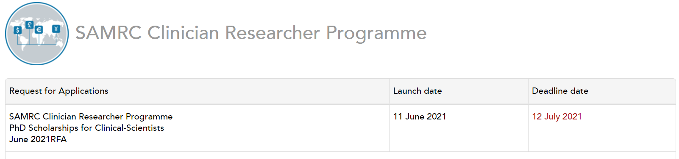
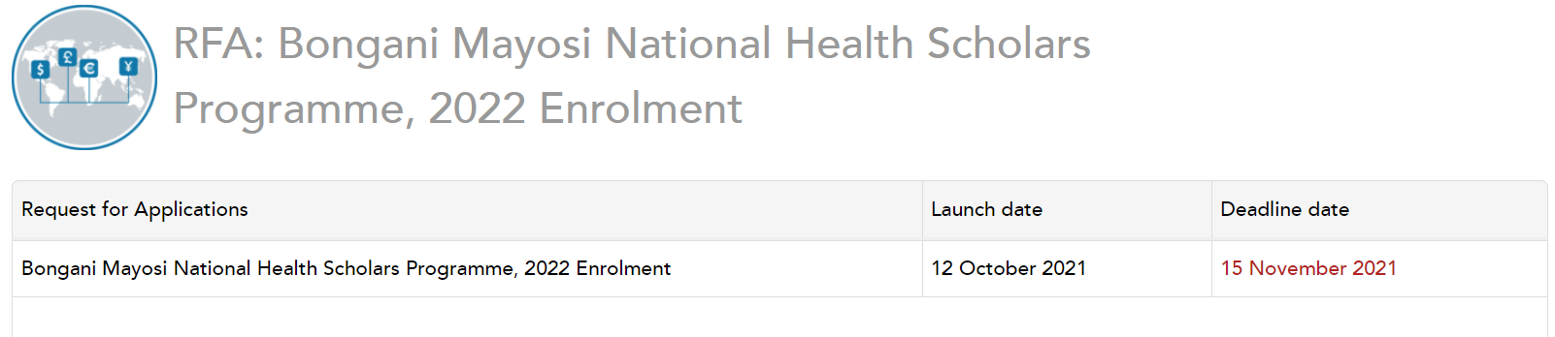
Calls targeted at health professionals
SAMRC Clinical Researcher Programme
  For medical/dental graduates for doctoral study; 1-4 yrs
Bongani Mayosi National Health Scholars Programme (SAMRC, NDOH, PHEF)
  For MBChB or master’s degree holders (limited by specific calls) for doctoral study
http://www.mrc.ac.za/funding/grants-and-scholarships
Notes:
SAMRC Clinical Researcher Programme
PhD Scholarships for Clinical-Scientists
https://www.samrc.ac.za/request-for-applications/samrc-clinician-researcher-programme
Aims to increase the number of clinician-scientists in South Africa who possess a PhD with full ability to conduct high-impact research and occupy leadership positions in the South African academic, clinical and research sectors
The full time PhD Scholarships will be only awarded to candidates with degree in medicine (MBChB) or dentistry (BDS). Must be South African citizen or Permanent resident.
Value of the scholarship is R500k p.a per scholar up to maximum of 4 yrs.
Bongani Mayosi National Health Scholars Programme (NHSP)
https://www.samrc.ac.za/request-for-applications/rfa-bongani-mayosi-national-health-scholars-programme
https://www.samrc.ac.za/request-for-applications/rfa-bongani-mayosi-national-health-scholars-programme-2022-enrolment
The Bongani Mayosi National Health Scholars Programme (BM-NHSP) is an initiative by the National Health Research Committee (NHRC) and a partnership between the National Department of Health (NDoH), the Public Health Enhancement Fund (PHEF) and the South African Medical Research Council (SAMRC).
The objective of the BM-NHSP is to fund the training of 1000 PhDs in health and clinical research over the next 10 years.
These are PhD scholarships.
There is no set amount of scholarship value. Funding is made available for a full degree period as a tax-free scholarship for full-time study. The value is equivalent to the after-tax take-home salary of the applicant, in terms of the public service professional scales applicable to the qualification(s) of the candidate (excluding overtime pay).
Applicants must hold MBChB or a master’s degree, but there are specific limitations depending on the specific call:
Call with deadline in Jul 2021 limit this to the applicant being registered at specific historically disadvantaged institutions.
Call with deadline in Nov 2021 limited this to applicants from specific backgrounds and doing PhDs in specific fields, namely it targeted the following health professionals: Professional nurses, Dentists and other oral health specialists, Pharmacists, Dieticians, Medical scientists, Occupational therapists, Optometrists and opticians, Physiotherapists, Psychologists, Speech therapists and audiologists, Biomedical engineers., who are in their first year of PhD study within the specialized research fields of Biostatistics, Data Science, Digital Health, Demography, Epidemiology, Health Economics, Genomics/Bioinformatics, Microbiology/Virology and Immunology.

Slide 18

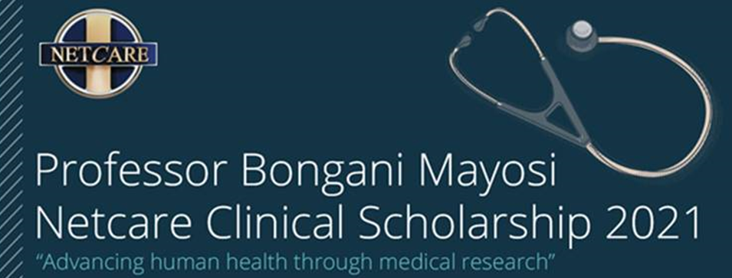
Calls targeted at health professionals
Discovery Foundation Academic Fellowships
  For recently qualified clinical (medical) specialists for postgraduate research (masters or doctoral)
  Must work in SA public sector for min 2 yrs after
Bongani Mayosi Netcare Clinical Scholarship
  For clinical specialists or subspecialists for doctoral or postdoctoral research
  Must work in SA for min 3 yrs after
Notes:
Discovery Foundation:
The recipients will have the opportunity to take on a period of full-time study and research towards Masters or Doctoral degrees.
There are two categories of academic fellowship awards available to medical specialists: The PhD award for research towards a Doctoral degree. The Masters award for research towards a Master’s degree by thesis or dissertation. This award may also contribute towards funding a fellowship in clinical medicine.
The PhD award provides funding of R800 000 for support to clinicians (preferably specialists) starting Doctoral research.
The Masters award provides funding of R600 000 to support clinicians (preferably specialists) starting research towards a Master’s degree by thesis or dissertation (MPhil, MSc)
Applications are invited from recently qualified clinical (medical) specialists. Applicants must have South African citizenship or permanent residency.
For those engaged in full-time Master’s or Doctoral research, the funds are intended as a salary to enable recipients to focus on their research, free of clinical duties. In the case of medical specialists who wish to pursue research towards a Master’s or a Doctoral degree parttime, the funds may be used for research, research-related support such as travel, time off clinical duties, and data personnel.
All recipients are expected to work in the public sector for at least two years after completing their research or degree
https://www.discovery.co.za/assets/discoverycoza/corporate/foundation-awards-2021/foundation-awards-application-book-2021.pdf
Bongani Mayosi Netcare Clinical Scholarship
Medical specialists who wish to further pursue an academic career to apply for funding from the Professor Bongani Mayosi Netcare Clinical Scholarship 2021 to pursue full-time doctoral or post-doctoral studies to be conducted in South Africa
Clinical specialist or subspecialist
3 yrs funding for full-time award.
Must work in SA for min 3 yrs after
Value is informed by the needs of the awardee. The grant does not include the funding for the research project.

Slide 19
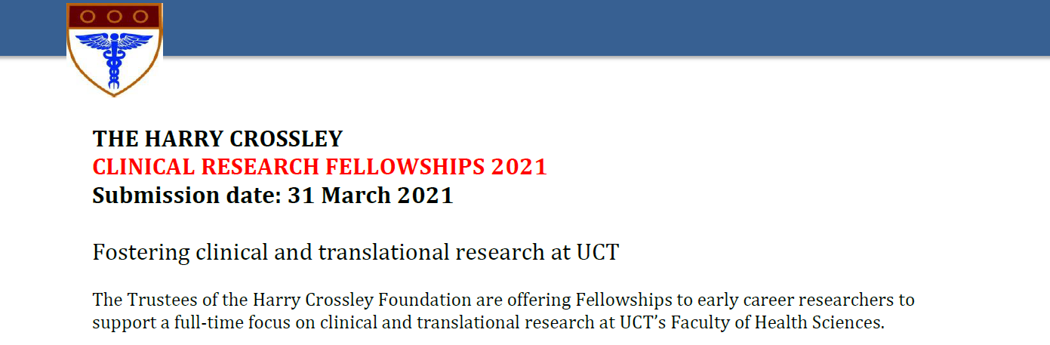
Harry Crossley Clinical Research Fellowships
Apply through UCT Faculty of Health Sciences
Funds for up to 1yr to support dedicated research time for early-career clinical, academic and research staff
E.g. to complete a PhD or deliver on a research project
Notes:
Harry Crossley clinical fellowships
In the last few years the Faculty has administered the awards of around 4-6 Harry Crossley clinical fellowships per year (4 in 2021).
These don’t provide full funding, but gives funds to support dedicated research time for early-career clinical, academic and research staff.
The award will provide busy clinical researchers and health professionals attached to the Faculty of Health Sciences the time required to, for example, complete a PhD or deliver on an important research project. Applicants should be under 45 years of age; in cases where fellowships are intended to support PhD completion, a more flexible age ceiling may be applied. Applicants should have an employment contract with UCT/PGWC that exceeds the duration of the award.
Value: up to R150, 000 per award (up to one year of support).

Slide 20
Ad hoc calls
Keep a look out for intermittent calls; recent examples:
  Schlumberger Foundation - Faculty for the Future Program (PhD & postdoc)
    https://www.facultyforthefuture.net/about-program
  ICGEB Arturo Falaschi Fellowship Programmes
  (PhD & postdoc)
    https://www.icgeb.org/activities/fellowship/

Slide 21


International Early/Mid-Career Awards
Wellcome Early-Career Awards
(next stage: Career Development Awards)
  Early-career researchers in UK, Republic of Ireland, LMICs
  Duration: Usually 5 yrs, but may be less for some disciplines, and longer if held part-time
  Eligibility: must have PhD or ≥4 yrs' equivalent research experience & generally no more than 3 yrs postdoc experience
NIH Emerging Global Leader Award (K43)
  Early career researchers who hold a junior faculty position at an LMIC institution
  Duration: Min 3, max 5 yrs
  Eligibility: must have Masters degree, PhD preferred, and hold an academic junior faculty/research position
https://wellcome.org/grant-funding/schemes/early-career-awards
https://grants.nih.gov/grants/guide/pa-files/PAR-21-252.html
Notes:
Wellcome
Discovery research: New schemes emphasis on support through the career stages
Career stage guidance: https://wellcome.org/grant-funding/research-careers – this tells you which grant schemes are relevant for you to apply to at your career stage.
Early-Career Awards
From any discipline
By the end of the award, they will be ready to lead their own independent research programme.
Significant benefits of being awarded a Wellcome fellowship
If you are a health professional and you want to continue with clinical activities, you must be registered with, and be licensed by, the relevant professional regulator in the country you intend to work in.
You should choose a research environment that provides you with the appropriate training, resources and experience to deliver your project and develop your research skills and identity. We encourage you to move away from your current research environment. This may mean moving from your group or department, but it is not essential to move organisations.
You can only hold one of these awards. We do not offer renewals.
Host organisation: UK, Republic of Ireland, LMICs (apart from India & mainland China)
Application process involves shortlisting and interviews (in London or remotely)
Note in 2021 some interviews were replaced with written responses – presumably only temporary
An early-career researcher can hold one Early-Career Award and be a coapplicant on a Discovery Award.
Funding: Salary & up to £400,000 for research expenses
NIH
Provide research support and protected time (three to five years) to an early career research scientist from a low- or middle-income country (LMIC) who holds a junior faculty position at an LMIC academic or research institution, as defined by the World Bank.
This intensive, mentored research career development experience is expected to lead to an independently funded research career at the LMIC institution or in another LMIC. This FOA invites applications from LMIC scientists from any health-related discipline who propose career development activities and a research project that is relevant to the health priorities of their country under the mentorship of LMIC and U.S. mentors.
Grants are available for a minimum of 3 years and may not exceed 5 years.
NIH will contribute up to $75,000 per year toward the salary of the career award recipient.
NIH will contribute up to $30,000 per year toward the research development costs of the award recipient.
Candidates must hold at least a masters degree that required a research thesis. Candidates with doctoral research training are preferred.
Applicants must currently hold an academic junior faculty position or research scientist appointment supported by the applicant LMIC academic or research institution and have been in this position for at least one year at the time the application is submitted.

Slide 22
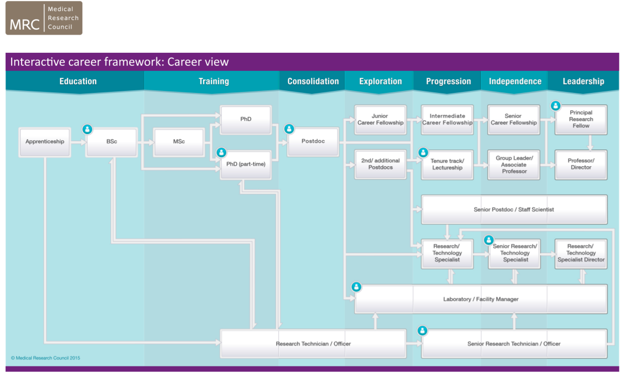
Interactive career tool (UK)
https://mrc.ukri.org/skills-careers/interactive-career-framework/#/home

Slide 23
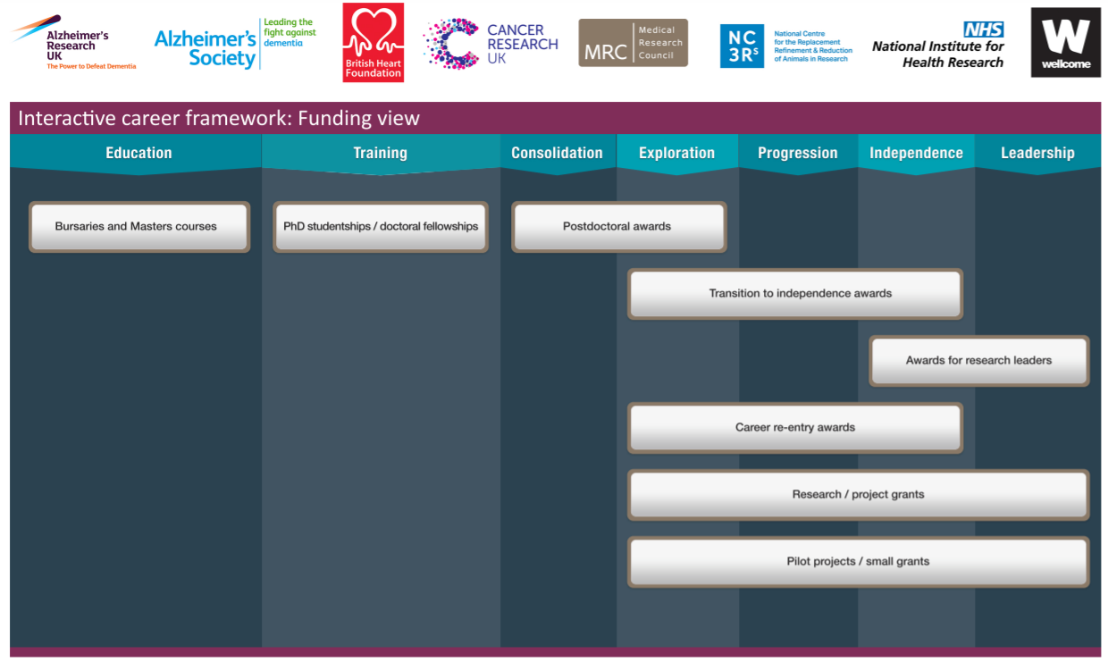
Interactive career tool (UK)

Slide 24
Support available
UCT & FHS Research Offices
  Can help with identifying funding opportunities; grant-writing advice & review; assistance with internal processes
    Emerging Research Programme
Funding opportunities are sent out via the UCT Research Announcement newsletter; you can subscribe: https://icts.everlytic.net/public/forms/h/1fnjNAIbYuyIuhhF/NzI0MGU1N2I3MWQ0YzkxNzM1OWFkYzgxYmI2YmJiMDk5MTA1ODMyOA==
Also look out for announcements on FHS mailers
Contacts:
  FHS Research Development team: research.health@uct.ac.za
  UCT International Grants Hub: internationalgrants@uct.ac.za
  UCT Research Support Services: researchfunding@uct.ac.za
  Postgraduate Funding Office: pgfunding@uct.ac.za
Notes:
In the Faculty Research Office we approve around 500 grant applications or contracts a year, so our researchers are constantly applying for funding to sustain their research.

Slide 25
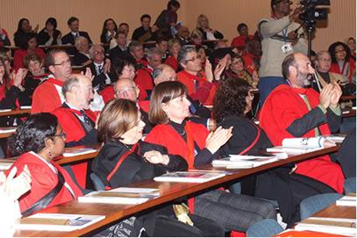
Support is available
You are not alone!
  Colleagues/fellow students
  Supervisor
  Mentor
  Departmental heads
  Graduate/Postgraduate office
  Postgrad student association
  Lab technicians
  Clinical site staff
  Admin/operations staff
  Research office
  Library staff
  Ethics/biosafety staff
  International relations office
  Contracts/IP staff
  Communications staff
  Funder
  Careers office

Slide 26

Thank you

