Slide 1
Presenting at conferences
Gary Maartens
Division of Clinical Pharmacology
Department of Medicine

Slide 2
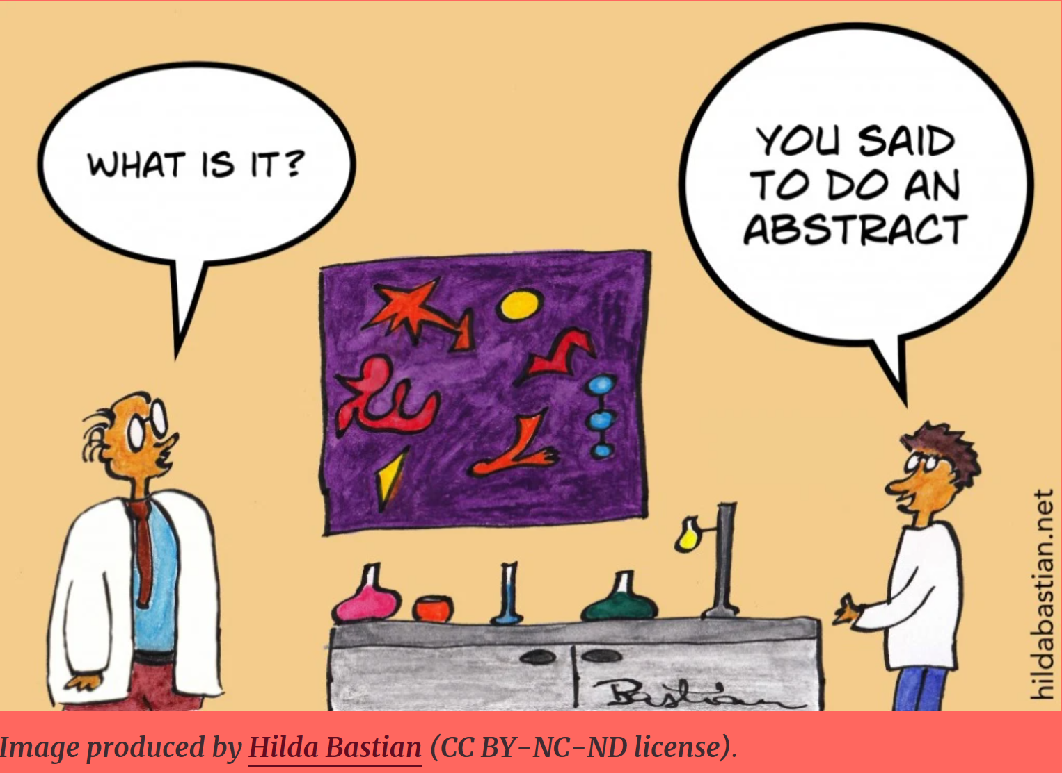
Preparing the abstract

Slide 3
Abstract basics
The abstract will be published in conference proceedings (& sometimes also in a journal), so it’s a standalone summary of your study
“I didn't have time to write you a short letter, so I wrote you a long one.” Mark Twain
Difficult to condense a study into 300-400 words
Must give supervisor/mentor time to craft it with you
READ THE INSTRUCTIONS
If it isn’t formatted properly likely to be rejected
Develop catchy but informative title
Important to submit to the right section

Slide 4
Abstract structure 1
INTRODUCTION/BACKGROUND
Keep as short as possible
Answer question: Why did you do the study?
End with your research question/s (best framed as hypotheses)
METHODS
Difficult to get balance right
Clinical research: design; setting; selection of patients; intervention; outcomes
Stats analysis plan can be shortened if standard approach & self-evident in results – sample size estimation is crucial

Slide 5
Abstract structure 2
RESULTS
Cannot include “data will be presented”
Many allow a table, which can have a lot of data
CONCLUSIONS
Keep it short
Must be supported by data
Give study limitations
If space allows, discuss genralisability

Slide 6
Preparing a poster
READ THE INSTRUCTIONS (especially size)
Avoid small font sizes
Need to read from ~1 m
Smallest 24 (except references)
Minimise text
Don’t clutter – “It's better to present a few of your findings well than present all of your findings poorly.” (ACP)
Make it colourful, but don’t overdo it - use a graphic designer
Be there when your poster session is scheduled

Slide 7
Oral abstract presentation
Time limit will be strictly applied
Number of slides strict (if not specified aim for 1 slide a minute):
Don’t animate to get around this
Don’t crowd the slides – white background best
Write out word for word what you plan to say & time it
Practice, practice, practice
Get to venue early; familiarise yourself with audiovisual; introduce yourself to the chair
Don’t over-use pointer

Slide 8
Before you go
Present to critical colleagues
Anticipate questions & practice answers (if you don’t know the answer to a question don’t make it up!)
Do research on groups working in similar areas
Networking is the most important part of conferences

Slide 9
Oral abstract
“Remember you are proud of your work, open to suggestions to improve your work and are honored to have been invited to present your work – congratulations!”
https://ripehosting.blob.core.windows.net/anzcvs-prod-media/2210/the-essentials-of-oral-abstract-presentation-anzcvs-v2.pdf

Slide 10
Useful resources
ABSTRACTS
https://www.acponline.org/membership/residents/competitions-awards/acp-national-abstract-competitions/guide-to-preparing-for-the-abstract-competition/writing-a-research-abstract
https://conferenceinference.wordpress.com/2020/05/04/capturing-the-abstract-what-are-conference-abstracts-and-what-are-they-for-james-burford-emily-f-henderson/
POSTERS
https://www.acponline.org/membership/residents/competitions-awards/acp-national-abstract-competitions/guide-to-preparing-for-the-abstract-competition/preparing-a-poster-presentation

