Slide 1
HISTORY OF DERMATOLOGY AT UCT
Dr Sandra Pather
MBchB(Natal) DCH(SA) MPhil(Epi) FCDerm(SA)
At the Launch of the Hair and Skin Research Lab
29 May 2015

Slide 3
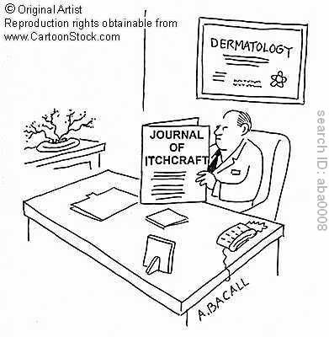
HUGH SMITH
1922
Physician
1st appointed lecturer in department
small weekly clinics <20 patients
shared houseman
Notes:
Apparently, when 1st medical students began their clinical years there were no qualified dermatologists in South Africa.
Remembered as highly cultured and competent lecturer and diagnostician.

Slide 4
DR MOREES BOSMAN
1930 – Head
1st dermatologist led department
Dr F Krone – assistant dermatologist
Clinics size and number grew including subsidiary clinics
need for dermatology training recognised
Dr R Lang – 1st registrar

Slide 5
“CINDERELLA” OF THE PROFESSION
Outpatient and clinical teaching facilities extremely limited
1931 – occupied a “tin shanty” on grounds of NSH
GSH planning – determined to create a carefully planned department that would be comparable to overseas department

Slide 6
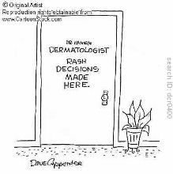
MOVE TO GSH
1938 – vision bore fruit
Autonomous department
Well planned outpatient facilities and 30 bed ward
Financial constraints precluded a laboratory

Slide 7
DR R LANG
1945 – head of teaching department at UCT and HOD of GSH
(Lang’s Modified Adamsons Ointment)
1950 – Dermatology incorporated as a Division of Medicine
Controversial
Dr Jean Walker – 1st graduate to receive an MD on “Skin and TB”
Notes:
Revolutionary changes in all departments at hospital. The honorary system was abolished and a joint agreement was drawn up bet PA and Depta were now paid on a sessional basis. Controversial – while this forged a closer relationship with our parent discipline i.e Internal Medicine, to secure the necessary funds to advance the department academically would be very limited as part of a larger group.

Slide 8
1962 – LABORATORY PROMISED?
1958 – Dr R Kooj joined department
“......a researcher of the first flight, and .......
as soon as our laboratory which has been promised to us for so long by the University and Provincial Administration,..................... the necessary research .....................will finally bring us up to international standard”

Slide 9
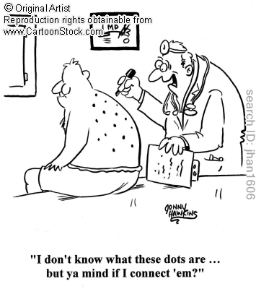
Notes:
Although these were the pioneers who paved the way,energetic heads of departments followed who transformed the department into an excellent clinical unit.

Slide 10
PROF WALTER GORDON
Enthusiastic and passionate dermatologist
Exemplary role model for teaching clinical dermatology
Started using “ pattern recognition” method of teaching dermatology
Developing extensive slide database
Notes:
Catch you in passage to see an interesting patient
Anecdote

Slide 11
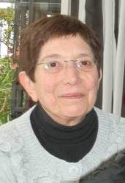
PROF NORMA SAXE
Strong interest in dermatopathology
Combined Dermatopathology Meeting
clinico-pathological correlation and improved diagnostic accuracy
Clinical teaching and research thrived under her wise and gentle encouragement and mentorship
Encourage women to train in dermatology
Notes:
Slight build but enormous stature
Challenge status quo

Slide 12
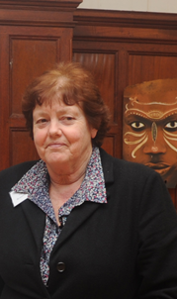
PROF GAIL TODD
dedication and courage
passionate adequate dermatology service in the community
an astute clinician – fought hard for providing adequate training for undergraduates in new curriculum
and undergraduate outreach field trips
Community Dermatology – dermatology nurse training and training in Africa
Contact Dermatitis expert – Occupational Skin Clinic - relationship with Dep of Public Health

Slide 13
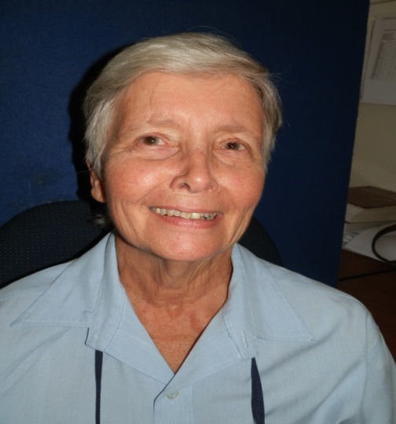
DR SUSAN JESSOP
Current longest serving member of the department
Auto-immune skin diseases – co founder of the Lupus Clinic as a 5th year medical student
Editor of Cochrane Skin Group
Education – instrumental in new undergraduate dermatology curriculum
Blended Course – on site and e- learning
Post graduate teaching
Notes:
3 main interests are auto-immune skin diseases, evidence based medicine and education

Slide 14
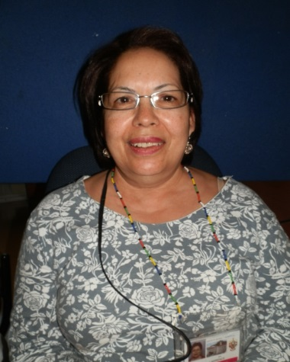
DR PAT LAWRENCE
Dermatologist at Red Cross Hospital
Set up paediatric dermatology Service
Passionate educator of doctors, nurses and patients
Oasis Dermatology Day Care Unit pioneered dermatology education and improved nursing care

Slide 15
DR LADUMA NGWANYA
Hair and Nail expert
Hair Clinic co-founder
Dermatopathology training
Undergraduate and postgraduate training
“memory bank”

Slide 16
DR RANKS LEHLOENYA
Clinical and Teaching
Expert on Severe Adverse Cutaneous Drug Ractions – PhD
Infectious Diseases Skin Clinic
Drug Allergy Clinic

Slide 17
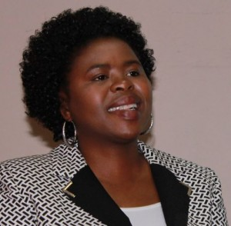
DR CAROL HLELA
Dermatologist at Red Cross Hospital
Improving the level of care of AE – RCT on choice of emmollients in AE
Paediatric dermatology as a subspeciality
NRF rated researcher with a PhD from Oxford on HTLV1 Skin Research

Slide 18
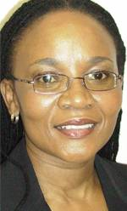
PROF NONHLANHLA KHUMALO
18 bed ward, many large outpatient clinics at GSH, and outlying areas
secured more undergraduate dermatology training time
Acclaimed and widely published hair expert
Hair and Skin Research Lab
Notes:
Secured a sizeable sum of funding to set up a world class lab. In so doing, she has realised the vision of the pioneers of dermatology and provided the department with an opportunity to marry the science of dermatology with the clinical practice of the discipline. The practice of medicine in the Public service is an arduous albeit gratifying experience – opportunity to salute the custodians of Dermatology at UCT who built and continue to build this department into the excellent unit it is and congratulate Khumalo on this achievement and wish the department well in this exciting endeavour. Cinderella is finally able to attend the ball in full attire.
Passionate educator of doctors, nurses and patients

