Slide 1
Vula: Intro to Item Analysis
Remote Teaching 2020
Centre for Innovation in Learning and Teaching
Unless otherwise stated, this resource is licensed under a CC BY 4.0 International license
Notes:
CILTers to introduce themselves with Video
HI everyone! Welcome and thank you for joining this webinar session on the VULA lessons Tool. This webinar will be co-presented by myself and Lubabalo. We have Shanali facilitating the room and Mary-Ann in the chatroom.

Slide 2
Item analysis guide
https://docs.google.com/document/d/1-snjOmEEqe3saQfXiJVEAV9JM2AFY4FzMKFH8S95N_g/edit

Slide 3
Poll: Do you know what item analysis is?
How extensively do you use T&Q?
Do you use question pools?

Slide 4
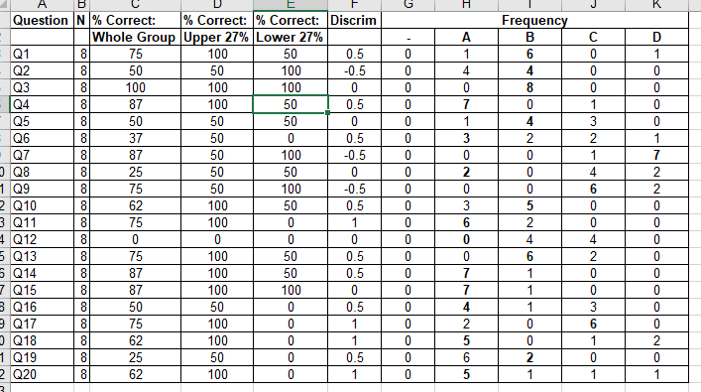
By the end of the webinar you’ll know what all of this means!

Slide 5
What is item analysis?
ITEM → Question
“Item analysis is a process which examines student responses to individual test items (questions) in order to assess the quality of those items and of the test as a whole.”
Notes:
From https://www.washington.edu/assessment/scanning-scoring/scoring/reports/item-analysis/#:~:text=Item%20analysis%20is%20a%20process,the%20test%20as%20a%20whole.

Slide 6
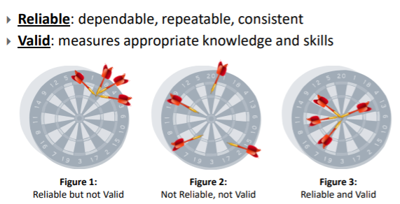
What is item analysis?
Do you trust your assessment results?
This helps with the RELIABILITY and VALIDITY of the overall assessment
Content validity, Criterion validity, Construct validity, Face validity
Notes:
From https://www.washington.edu/assessment/scanning-scoring/scoring/reports/item-analysis/#:~:text=Item%20analysis%20is%20a%20process,the%20test%20as%20a%20whole.

Slide 7
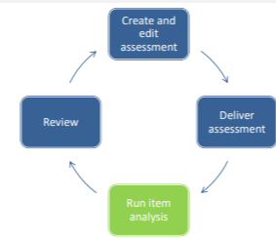
Why item analysis
How hard or easy is a question?
→ Revise question bank: Which questions to keep, modify or discard → Improve the reliability and validity.Remove weak distractors (no one chooses, ambiguous, easy to guess)
→ Improve student motivation?
→ Grading Help finalise the score e.g. exclude a question from the grading
→ Content: What sections are students doing well in or not. e.g. a large number of students miss an item, misconceptions (distractors)

Slide 8
Why item analysis

Slide 9
Offers guidance
Helps flag
Depends on sample
Other types of review e.g. content, bias
Notes:
From https://www.washington.edu/assessment/scanning-scoring/scoring/reports/item-analysis/#:~:text=Item%20analysis%20is%20a%20process,the%20test%20as%20a%20whole.

Slide 10
What is item analysis?
We look at measures like:
Percentage correct (item difficulty)
“percentage of the sample taking the test that answers that question correctly”
Discrimination Index (DI)
“how well a question distinguishes between those with more skill from those with less skill”
Notes:
From https://www.washington.edu/assessment/scanning-scoring/scoring/reports/item-analysis/#:~:text=Item%20analysis%20is%20a%20process,the%20test%20as%20a%20whole.

Slide 11
Percentage correct (item difficulty)
How well the questions perform per student and as a group
Item difficulty index ranges from 0 to 100; the higher the value, the easier the question.
“easy” if the index is 85% or above;
“moderate” if it is between 51 and 84%;
“hard” if it is 50% or below.
Percentage correct = | Number of students who answered correctly
 | Number of students who answered the question
Notes:
Discrimination Index by subtracting the number of students in the lower group who got the item correct from the number of students in the upper group who got the item correct. Then, divide by the number of students in each group (in this case, there are five in each group). For Question #1, that means you would subtract 4 from 4, and divide by 5, which results in a Discrimination Index of 0.
Item discrimination can be calculated by ranking the students according to total score and then selecting the top 27 percent and the lowest 27 percent in terms of total score. :
Correct answered from Low scoring students for Q1- high scoring students for question 1/ number of students in each group

Slide 12
Simple analysis of percentage correct
Question | Correct answers | Total responses | Percentage correct | Comment
1 | 70 | 90 | 77% | Majority of students got this question right and could be classified as a fairly easy question.
2 | 30 | 50 | 60% | This score indicates a medium difficulty question
3 | 10 | 100 | 10% | This question is extremely difficult with a small number of students who got it right.

Slide 13
Question
% correct
Discrimination Index (DI)
Question options with student selections - this was a multiple select question
N - number of students
Since it’s a question pool you’ll have < total N
% correct
For upper and lower performers

Slide 14
Discrimination Index (DI)
The discrimination index meausures how well a question/item distinguishes between the high performers and low performers on the assessment.
Notes:
Item discrimination ability of an item to differentiate among students on the basis of how well they know the material being tested. Better performing students should generally do better versus the poor scoring student will do poorly

Slide 15
How is the Discrimination Index (DI) calculated?
The Vula Item Analysis calculates the discrimination index as the difference between the achievement of the upper 27% and lower 27% students on each question. Conceptually the procedure used is:
Step 1: Rank the test scores from high to low
Step 2: Group the high and low 27% of students
Step 3: Calculate the percentage correct (item difficulties) for both the upper and lower performers for each question.
Step 4: Subtract the lower performers item difficulty from that of the upper performers to get the discrimination index. For e.g. 0.87 - 0.23 = 0.64
27% high performers
27% low
performers

Slide 16
What’s a good DI?
< 0% | Check item for error
0-24% | Usually unacceptable - might be approved
25-39% | Good item
40-100% | Excellent item

Slide 17
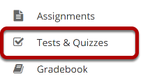
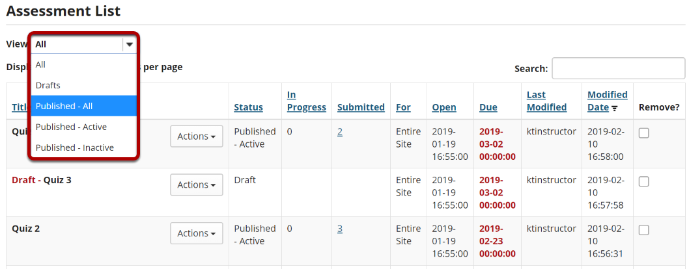
Finding item analysis on Vula

Slide 18
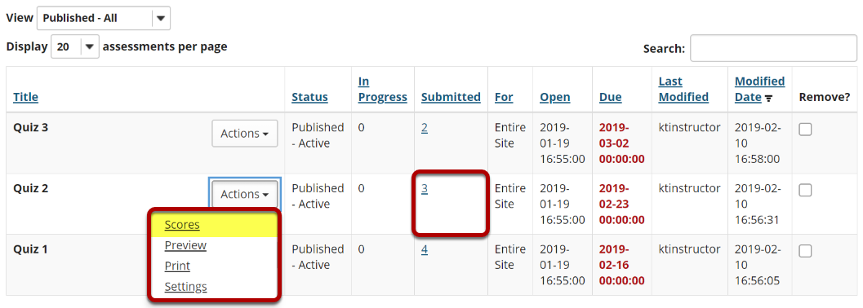
Finding item analysis on Vula

Slide 20
Vula - The Questions tab

Slide 21
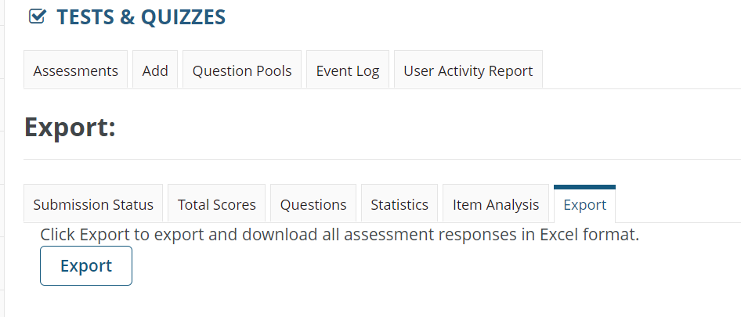
Exporting data

Slide 22
Let’s interpret some DI: Example
Question | % Correct: Whole group | % Correct: Upper 27% | % Correct: Lower 27% | DI | Comment
P1-Q6 | 24% | 22 | 27 | -0.05

Slide 23
Let’s interpret some DI: Example
Question | % Correct: Whole group | % Correct: Upper 27% | % Correct: Lower 27% | DI | Comment
P1-Q6 | 24% | 22 | 27 | -0.05 | More low performers got the question right than high performers. This question does not discriminate between top and bottom performers. Here we also need to look at the overall correct %. Only 24% of students got this right, classifying this as a difficult or possibly tricky question.

Slide 24
Let’s interpret some DI; Example
Question | % Correct: Whole group | % Correct: Upper 27% | % Correct: Lower 27% | DI | Comment
P1-Q10 | 22% | 28 | 17 | 0.10

Slide 25
Let’s interpret some DI; Example
Question | % Correct: Whole group | % Correct: Upper 27% | % Correct: Lower 27% | DI | Comment
P1-Q10 | 22% | 28 | 17 | 0.10 | Flatlining - little difference between high and low performing students. Only 22% of students got this right, classifying this as a difficult or possibly tricky question.

Slide 26
Let’s interpret some DI: Example
Question | % Correct: Whole group | % Correct: Upper 27% | % Correct: Lower 27% | DI | Comment
P2-Q9 | 41% | 66 | 11 | 0.54 | .

Slide 27
Let’s interpret some DI: Example
Question | % Correct: Whole group | % Correct: Upper 27% | % Correct: Lower 27% | DI | Comment
P2-Q9 | 41% | 66 | 11 | 0.54 | This question discriminates between high and low performers. This is a medium-hard question as overall only 41% get it correct.

Slide 28
Let’s interpret some DI: Example
Question | % Correct: Whole group | % Correct: Upper 27% | % Correct: Lower 27% | DI | Comment
P2-Q9 | 99% | 100 | 98 | 0.01

Slide 29
Let’s interpret some DI: Example
Question | % Correct: Whole group | % Correct: Upper 27% | % Correct: Lower 27% | DI | Comment
P2-Q9 | 99% | 100 | 98 | 0.01 | Very easy question with little discrimination

Slide 30
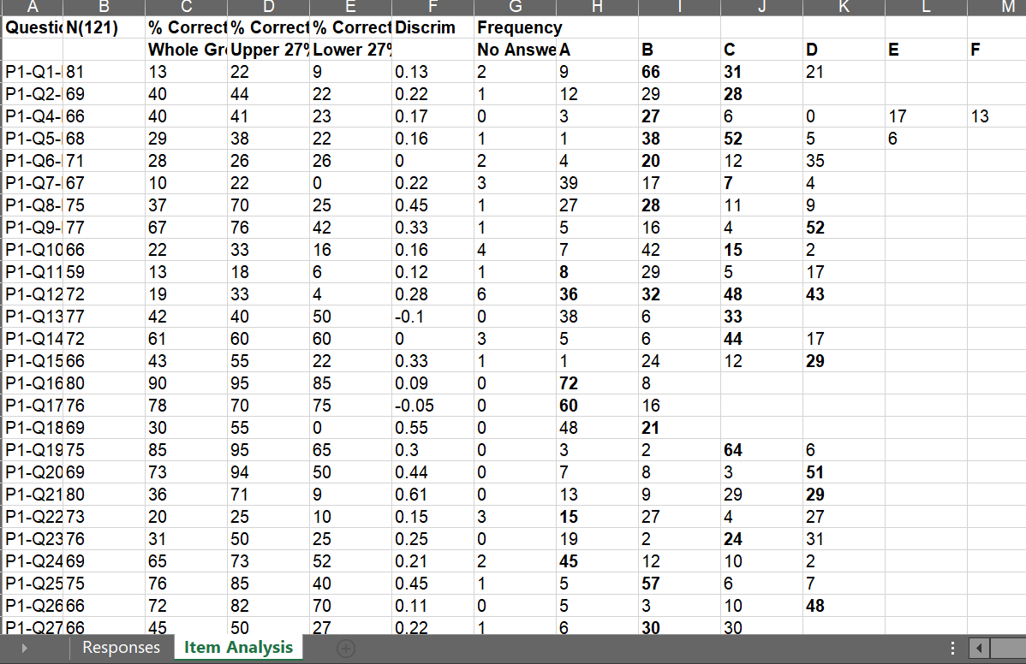

Slide 31
Item analysis guide
https://docs.google.com/document/d/1-snjOmEEqe3saQfXiJVEAV9JM2AFY4FzMKFH8S95N_g/edit

Slide 32
Find this resource and more at:
www.cilt.uct.ac.za/cilt/remote-teaching
Follow @CILT_UCT on Twitter
Unless otherwise stated, this resource is licensed under a CC BY 4.0 International license
Remote Teaching 2020
Centre for Innovation in Learning and Teaching
Notes:
Additionally, if you looking for more resources, you can find those at the UCT CILT website, which is brought to you by the Centre for Innovation in Learning and Teaching. All of the images in this screencast are publically available and freely re-usable. So please feel free to reuse this screencast. Thanks so much for listening. Bye for now.

Slide 33
References
https://www.geneseo.edu/sites/default/files/sites/education/p12resources-item-analysis-and-instruction.pdf
https://support.questionmark.com/sites/default/files/abp-item-analysis-kleeman-25-jan-2019.pdf
Notes:
From https://www.washington.edu/assessment/scanning-scoring/scoring/reports/item-analysis/#:~:text=Item%20analysis%20is%20a%20process,the%20test%20as%20a%20whole.

