Slide 1
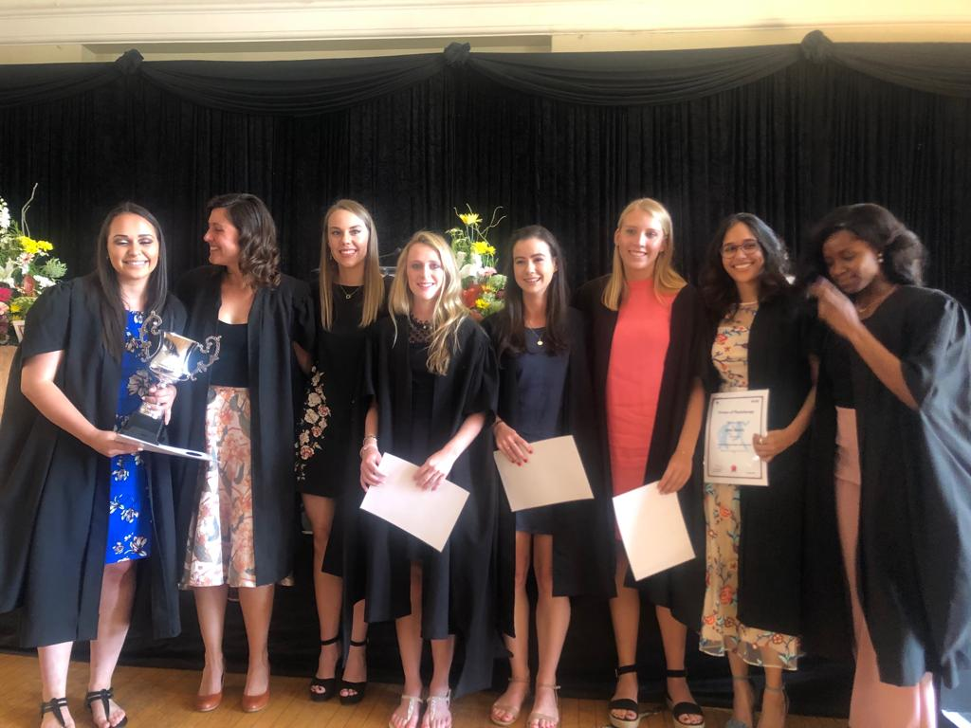
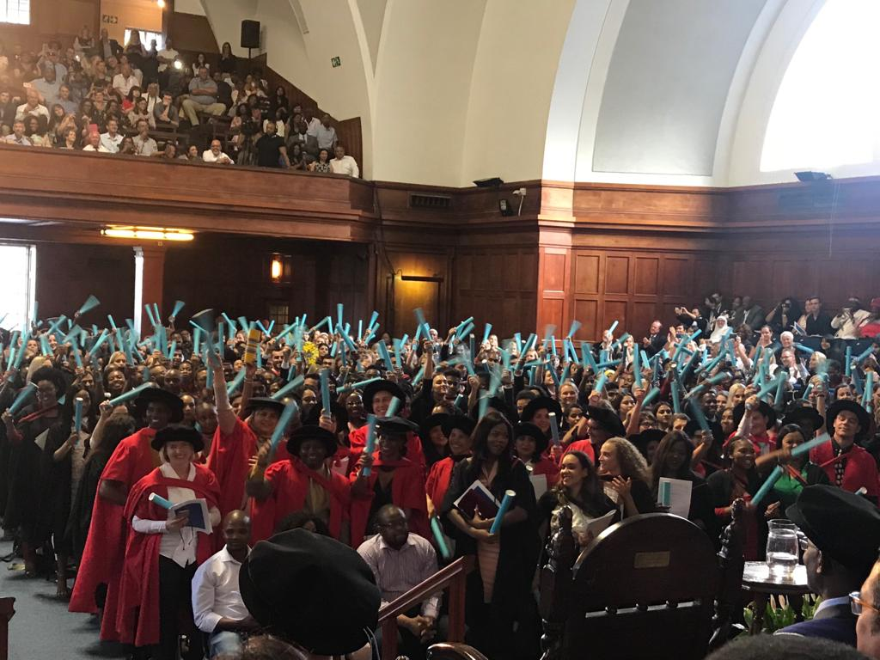
Grad 2018
BSc Physiotherapy students who were awarded the degree with distinction.
Congratulations to all our UG and PG students who graduated in 2018.
Congratulations to Zenzo Chakara who graduated with MSc in Audiology. Congratulations also to his Supervisor: A/Prof Lebogang Ramma.

