Slide 1
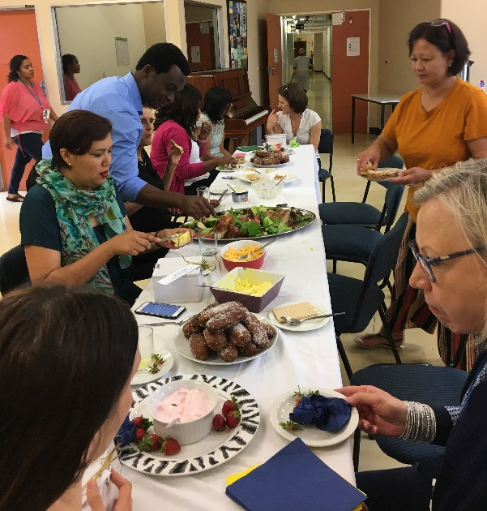
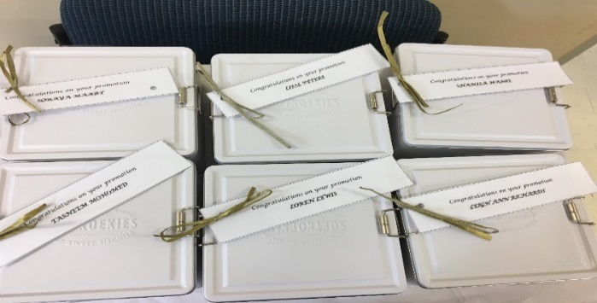
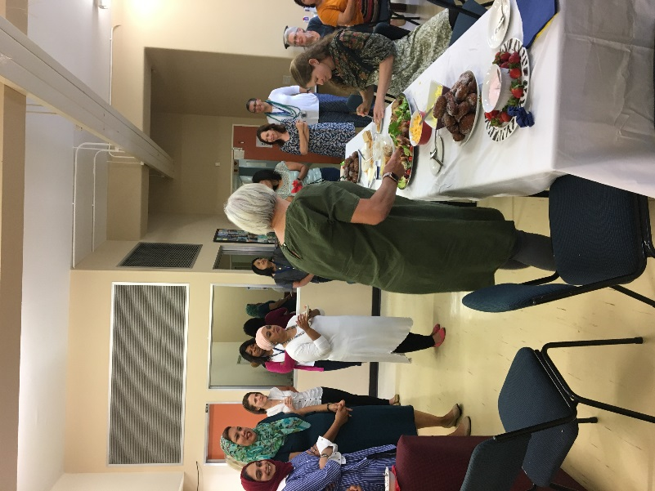
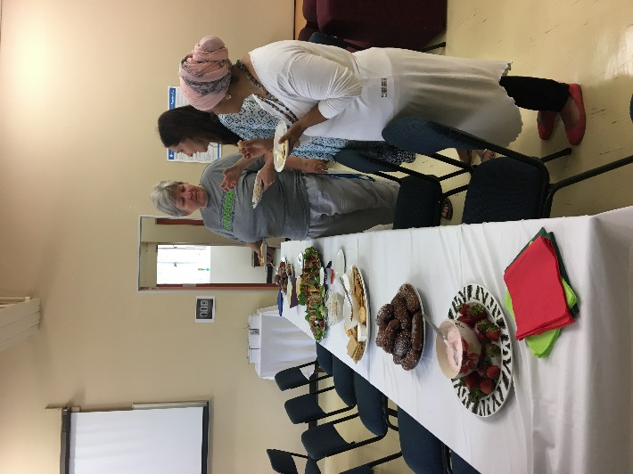
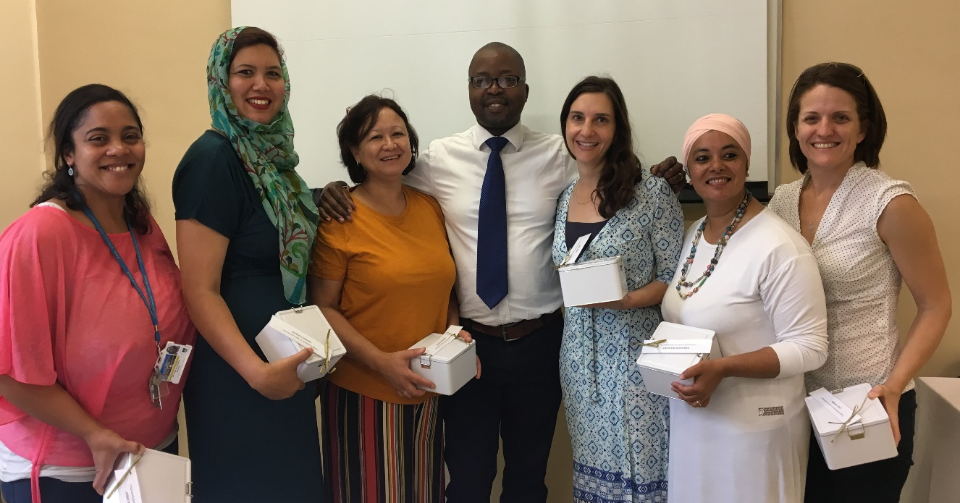
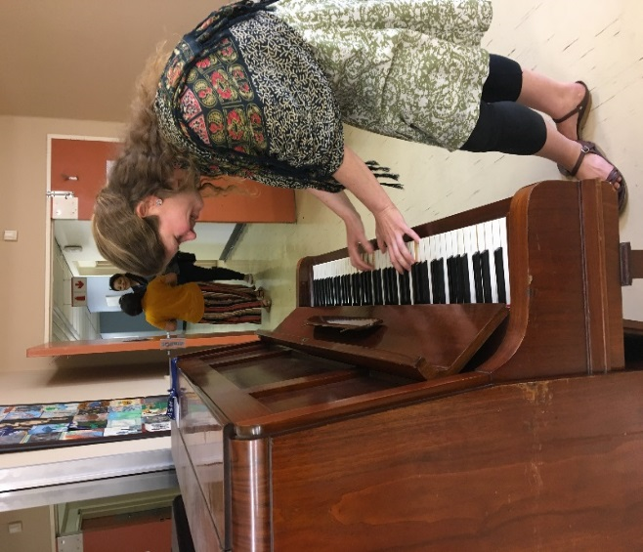
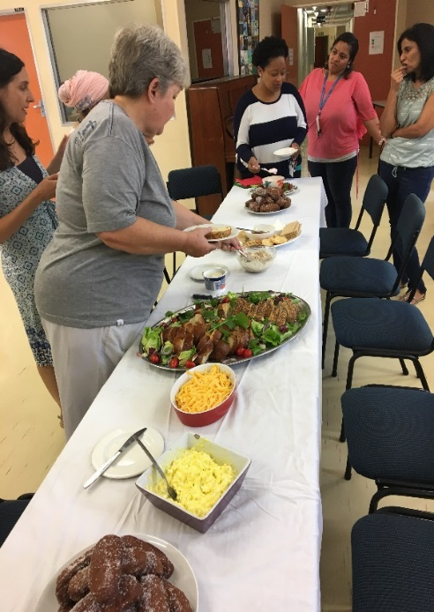
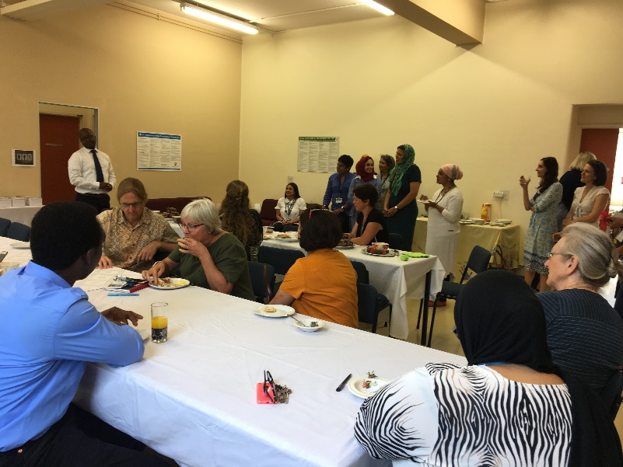
Ad Hom Promotions
Congratulations to our Ad hominers 2018, who has been promoted to:
Associate Professor
Soraya Maart
Senior Lecturer
Liesl Peters
Shamila Manie
Senior Clinical Educator
Loren Lewis
Lee-Ann Richards
Tasneem Mohamed
Lebo spoilt our adhominers with a lovely gift and a light breakfast. Staff joined in the celebrations…anything for a free treat!!!

