Slide 1






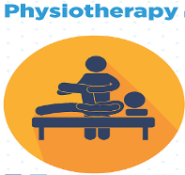


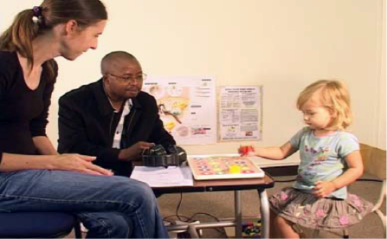
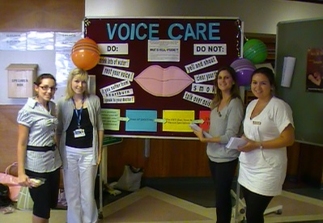

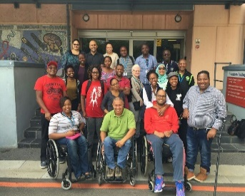

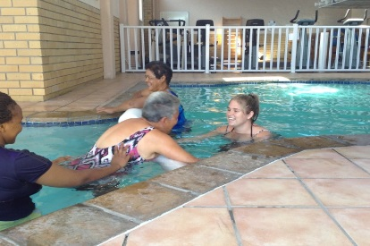

Nursing & Midwifery

Slide 2

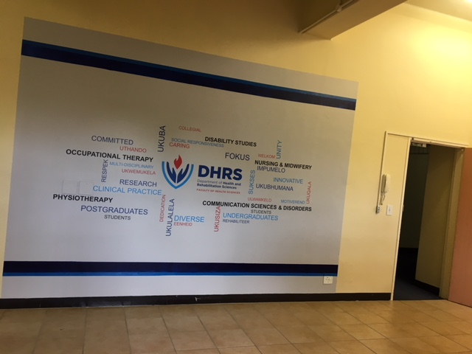
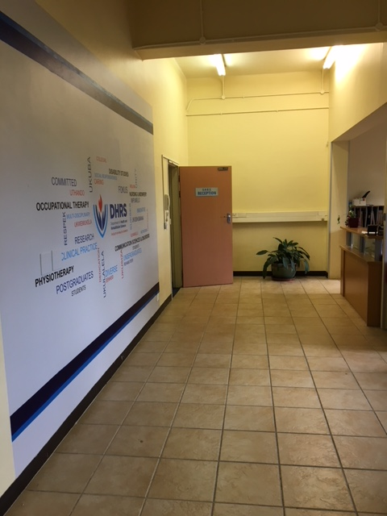
DHRS Reception

Slide 3
DHRS Launch of New Logo
The “hands” simultaneously symbolise the participation of the department’s employees and students and the inclusion of people from all walks of life.
The “flame” represents life and is held together by the hands indicating the care the department of Health and Rehabilitation Sciences take to ensure a qualify of life for their employees, students and patients.
The “shield” is aligned to the UCT shield shape, this logo contains metaphors for inclusion, participation and the cherishing of life.

Slide 4

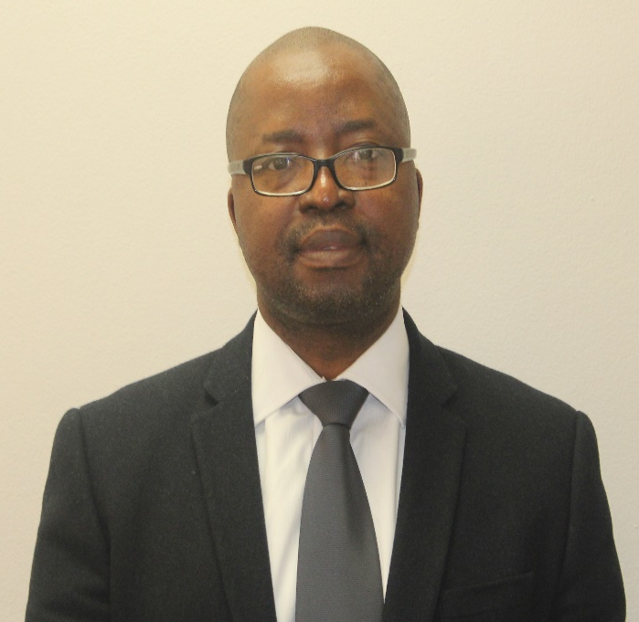
HOD Corner
Dear Colleagues
We have made it to the end of yet another tough academic year and I want to take this moment to Thank each one of you for your contributions in getting us through the year. 2018 was an eventful year, with notable highs and lows. Some highlights included, successful ad hominem promotions of all of the applicants from the Department, Dr Brian Watermeyer receiving his NRF rating and the most successful and inspiring retirees seminar for Professor Amosun and Professor Duncan.
Of course, we also had low moments during 2018, the most memorable being the untimely death of our beloved Dean, Professor Bongani Mayosi. May his soul rest in peace. Another low point this year had to be the difficult engagements between the Department and the Deanery around renewal /extension of contracts of key staff members in the Department which will certainly impact negatively on our operations next year. Finally, an exodus of our competent and most loved administrators within a short space of time also represents a low for the department during 2018.
As we bid farewell to 2018, and looking forward to usher in 2019, let us all reflect on the challenges of this past year; some of our students do not trust some of our processes, especially those relating to assessments. We need to work on a strategy get our students to trust those processes again. We also need to actively engage with our students' initiative around addressing destructive hierarchical structures/practices in the Faculty of Health Sciences.
I wish you all a restful holiday season and I look forward to working with you to deliver yet another successful academic year in 2019.
Sincerely,
Lebogang
HOD: A/Prof Lebogang Ramma

Slide 5



Division of Disability Studies
Ikechukwu Nwanze at the Disability Studies Division presented at the International Access Week Seminar, UCT Open Access on the theme ” Academic voice: Accessibility of information for students with disabilities” on 26 October 2018. Link to programme: http://www.lib.uct.ac.za/news/open-access-week-seminar-designing-equitable-open-access-foundations-social-justice
He also presented at the Online education and research platforms – inaccessibility of disable students and staff called by A/Prof Lis Lange (DVC: Teaching and Learning) at Hlanganani Junction – Libraries Upper Campus.
The TEDI project recently piloted their third face-to-face course - Teaching learners with Visual Impairment (Low vision and Blindness) - held at the Faculty of Health Sciences, University of Cape Town, from the 01st to 05th of October 2018. The course participants were educators of learners with visual impairment.
Adopting a holistic approach, the course focused on:
• Classroom accommodations and curriculum differentiation
• Accessible LTSM (learning and teaching support materials)
• The expanded core curriculum
• Assistive technology
• Psycho-social implications
• Understanding disability as a human rights and social justice issue.
Here is a write up in the Tatler on the course: https://www.southernsuburbstatler.co.za/news/pilot-teaching-course-lights-up-the-way-17436679
The Division of Disability Studies is very proud to announce the graduation of three MPhil candidates in 2018, Marlene le Roux, Rachael Wanjagua and Jane Harrison.
Congratulations to
Dr Brian Watermeyer who received an NRF C1 rating! Well done on your achievement!
Congratulations to Judy McKenzie, Brian Watermeyer and Leslie Swartz on their recent publication entitled The Palgrave Handbook of Disability Citizenship in the Global South.
This handbook questions, debates and subverts commonly held assumptions about disability and citizenship in the global postcolonial context.
Provides a much needed perspective on the relationship between disability and citizenship in the Global South
Engages the unique case of the South African experience at a time of ongoing democratic transition
Brings together an eclectic group of authors from academia, the policy world as well as civil society, engaging with hands on questions and issues surrounding everyday challenges of the disabled: from transportation, to participation in the broader economy”
The TEDI project team will also be presenting it’s research at the 6th Annual Disability Rights Conference on the 6-7 of November 2018 in Pretoria. The theme of the conference is addressing the barriers to implementation of inclusive education in the African region.
For further information on the TEDI project please go to: http://www.dhrs.uct.ac.za/dhrs/divisions/disability/tedi
Prof Theresa Lorenzo has introduced very successful monthly Writing Circles for the PhD in Disability Studies students in the second semester of 2018. Well done to the PhD students who have made such good progress!

Slide 6
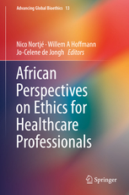
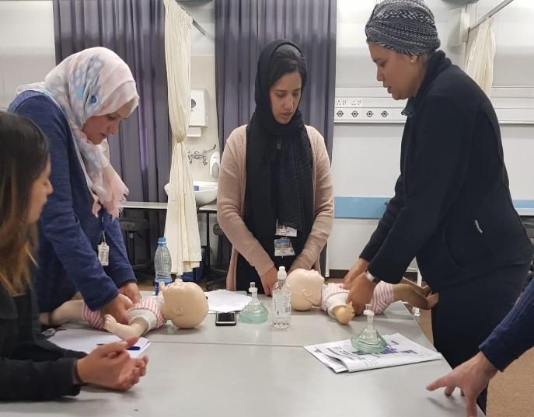
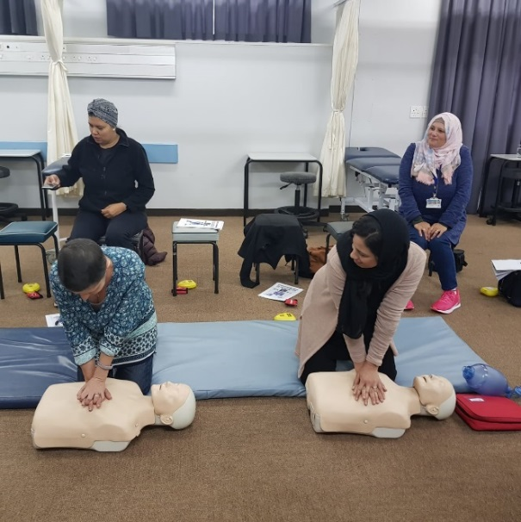
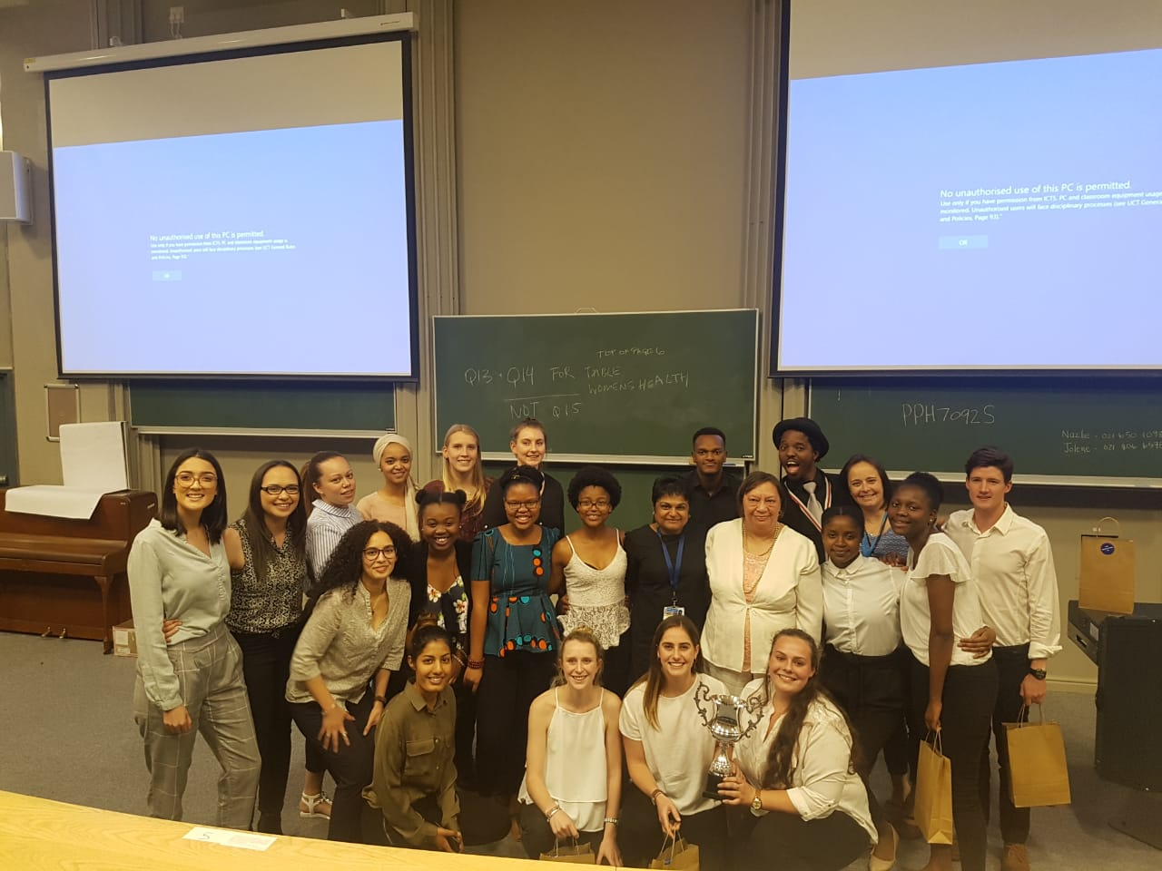

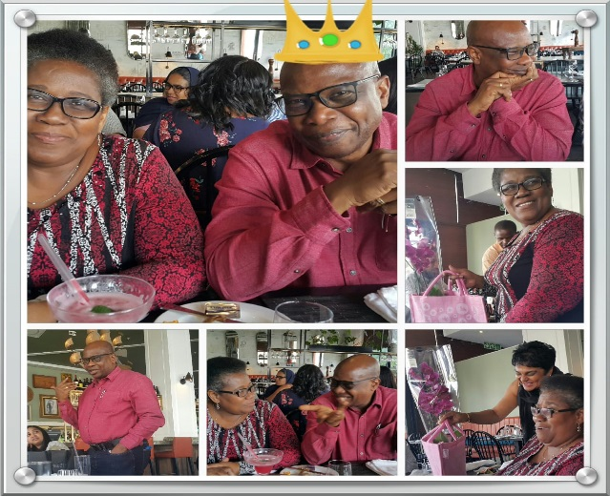
Division of Physiotherapy
Below:
HoDiv, Dr Niri Naidoo with the winners of the 4th year Physiotherapy research day!
Congratulations to Dr Theresa Burgess and Emeritus Professor Jennifer Jelsma whose recently published a chapter in the book “African Perspectives on Ethics for Healthcare Professionals” . A wonderful achievement for both of you, we are very proud and trust that the book will be a resource for all our DHRS students in the near future.
The Physio staff attended a CPR training session hosted by Basic Life Support.
Mail & Guardian’s 200 Young South African’s Award
Ms Kim Buchholtz has received the 2018 Mail & Guardian’s 200 Young South African’s Award for her work in Exercise and Sports Physiotherapy and especially her work at UCT. This Incredible recognition for the excellent work and contributions being made by UCT DHRS and Physiotherapy staff members to the training of health professionals and health care in South Africa.
Please follow the attached link for a full description of Kim’s profile for the Award: http://ysa.mg.co.za/2018/kim-buchholtz/
CONGRATULATIONS!!!!
Please join me in congratulating Sara Warren who has passed her MSc in Physiotherapy! Dissertation title: The effects of a six-week pre-operative, physiotherapy led exercise and education intervention on post-operative recovery, in terms of pain and function, in patients with osteoarthritis, undergoing total knee replacement in the Western Cape. Congratulations also to her brilliant supervisors: A/Prof Romy Parker and Ms Melissa Saw.
A very special postgraduate student- Ms Anri Human (registered for PhD in Physiotherapy) and supervised by Prof Brenda Morrow and Prof Jennifer Jelsma At the recent International Congress on Neuromuscular Diseases (ICNMD 2018) in Vienna, Austria Anri received first prize for her poster in the section on congenital/hereditary conditions. Well done Anri, another excellent achievement!
To Sarah Language who has passed her MSc in Exercise Science and Sport Physiotherapy! Well done Sarah on this fantastic achievement! Congratulations are also extended to Sarah’s supervisor, Dr Theresa Burgess!
The division had a Farewell party for Prof Dele. He was accompanied by his beautiful wife Dr Amosun.

Slide 7
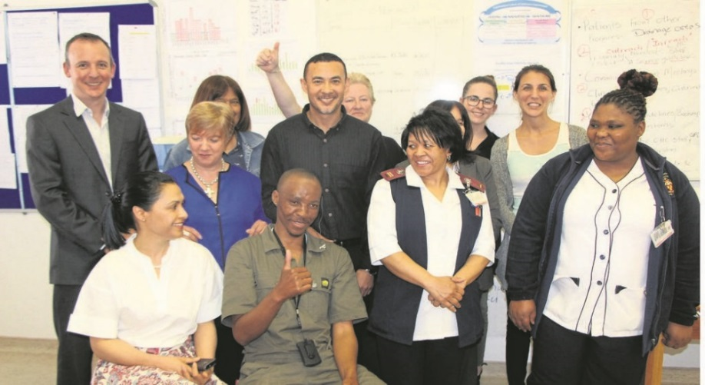
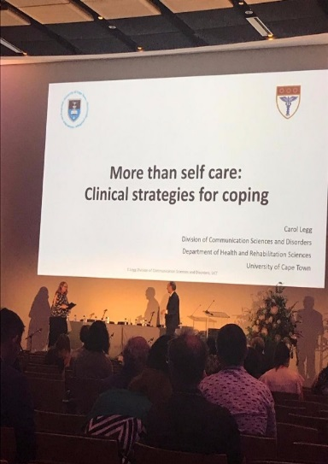
Division of Communication Sciences and Disorders
Carol Legg (right) presents her research at the 34th World Congress of Audiology / SASLHA Conference. Carol described her work with speech-language therapy students in clinical debriefing sessions. This project, of relevance to all our students in the clinical years, will be the subject of one of DHRS's lunchtime seminars in 2019 - watch this space for more information!
Message from HoDiv, Dr Michelle Pascoe:
October was an important conferencing month for our Division. The 34th Word Congress of Audiology was held in Cape Town at the CTICC and many of our staff from both Audiology and SLP programmes participated. This is the first time this important congress has been held on African soil and it was a resounding success (excuse the pun!) with CSD very well represented.
Meanwhile some staff missed out on the local fun to attend the International Clinical Linguistics and Phonetics Conference held in Malta. CSD staff were invited to participate in a panel celebrating the 70th anniversary of the UN Declaration of Human Rights and in particular Article 19 and its focus on communication and human rights. The International Journal of Speech Language Pathology has produced a special edition of their journal entitled "Communication is a human right: Celebrating the 70th anniversary of the Universal Declaration of Human Rights" which is freely available for downloading here: https://www.tandfonline.com/toc/iasl20/20/1
On a different note the division is sad to say farewell to Warda Samaai and Celeste Edwardes (Sameuls) who will be leaving us for new career adventures. They will be sorely missed but we are grateful to them both for their amazing contributions and being wonderful colleagues and friends.
People’s Post
https://www.news24.com/SouthAfrica/Local/Peoples-Post/the-gift-of-hearing-20181022-2
The first ever cochlear implant at Groote Schuur Hospital has completely changed the life of a 37-year-old man. Xolani Maxhego of Gugulethu went from being profoundly deaf to being able to have a normal conversation with his family and friends. Med-El partnered with ENT specialist Tasneem Harris, audiologists Adri Schlichting and Zane Solomons, rehabilitation specialist Nikki Keeton, and the hospital, to make the project a success. Keeton explained that a lot of programming takes place with cochlear implants and one needs specialised training to know how it works. She said Maxhego was lucky to be able to hear the moment the device was switched on. According to Keeton, patients who have had long-standing deafness would need a lot of training to understand how sound works and learn to hear again.
A/Prof Lebogang Ramma and Lucretia Petersen had a workshop at the World Congress of Audiology on 27 October which was held in the Wolfson Lecture Theatre.
Lebo and Zenzo presented on ”Genetics of Hearing Loss”.
Lucretia presented on ”Transformation of the audiology profession”.

Slide 8
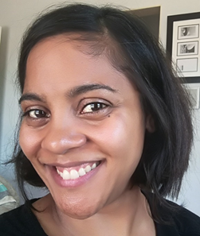
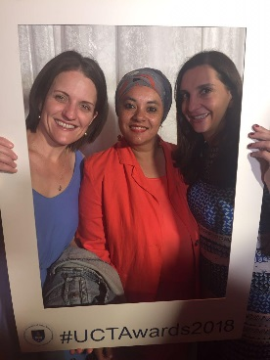
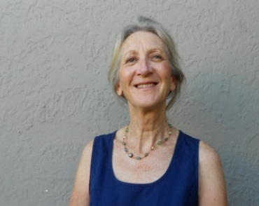
Division of Occupational Therapy
Dear Students, Academic and Clinical Colleagues, Administrators, Security and Cleaning Staff & Friends,
You may be aware that I retire in December. It has been a privilege to work alongside all of you in various roles, places and spaces over the past 25 years. Thank you very much for enriching my work life with your friendly smiles and willingness to go the extra mile when the going got tough. Thanks too for extending grace when I made mistakes and helping me to grow personally and academically.
As I say goodbye and prepare for re(F)irement (yes…. a second career awaits….) I share some borrowed parting thoughts for reflection:
The Roots Of Our Problems Are:
Wealth Without Work, Pleasure Without Conscience, Knowledge Without Character, Commerce Without Morality, Science Without Humanity, Worship Without Sacrifice, Politics Without Principles.” – Mohandas K. Gandhi
A Solution to Our Problems May Be:
"I am done with great things and big plans, great institutions and big successes. I am for those tiny, invisible loving human forces that work from individual to individual, creeping through the crannies of the world like so many rootlets, or like the capillary oozing of water, yet which, if given time, will rend the hardest monuments of human pride." - William James
My Parting Blessing For You
May the road rise up to meet you,
May the wind always be at your back,
May the sun shine warm upon your face
And the rains fall soft upon your fields
And until we meet again,
May God hold you in the palm of His Hand
– Traditional Irish Blessing
Message from the HoDiv, Dr Amshuda Sonday:
“It’s time to say goodbye, but I think goodbyes are sad and I’d much rather say hello. Hello to a new adventure.” Ernie Harwell.
We are saying goodbye to a dearest colleague in our division, which is not always an easy thing to do. Fondly known as Maddie, I will begin to appreciate her calm, gentle nature and how she amazingly couples this calmness with an explicable wisdom. Madie has been a part of the division of occupational therapy and will always remain as one of our legends! We are really going to miss you!
Warmest, Amshuda
UCT Annual Awards
Frank Kronenberg graduated with PhD – Supervisors were Professor Harsha Kathard, Professor Debbie Rudman and Professor Ramugondo.
Fadia won the “Best Publication 2017 Early Career Ward, Public Health and Rehabilitation Sciences”.
A farewell to Steve Barker who has been a valued member of the OT division for the past 5 years.
Professor Elelwani Ramugondo has been promoted to Deputy Dean Postgraduate.
FAREWELL !!!
A/Prof. Eve “Madie” Duncan
Congratulations to Liesl, Tasneem, Loren and Leigh Ann.

Slide 9

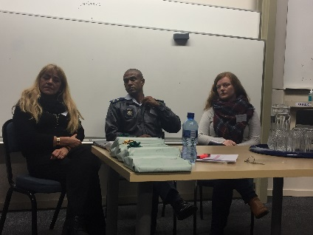
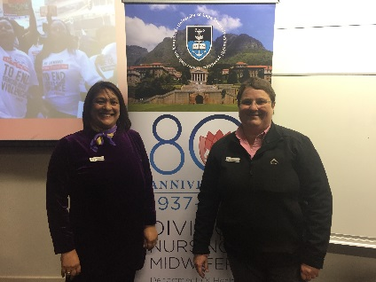
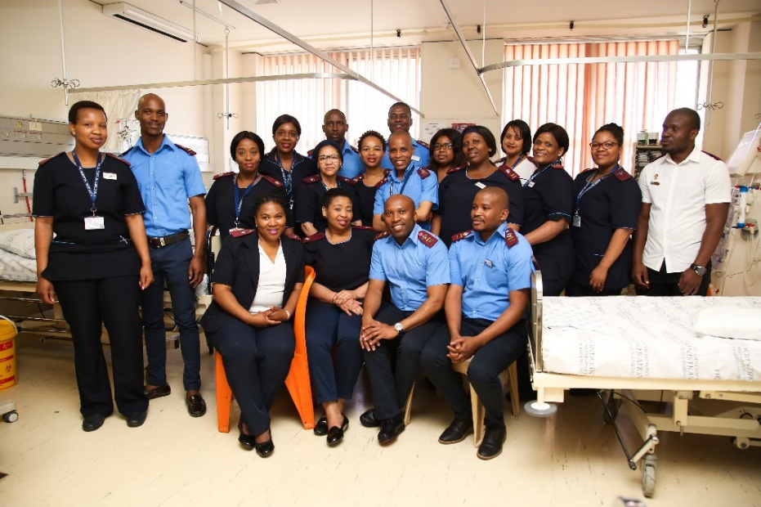
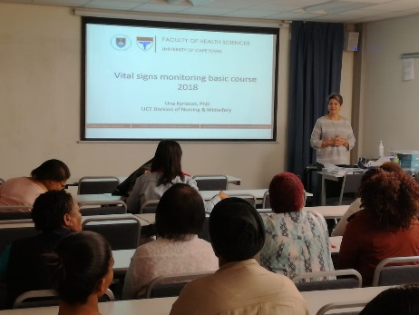
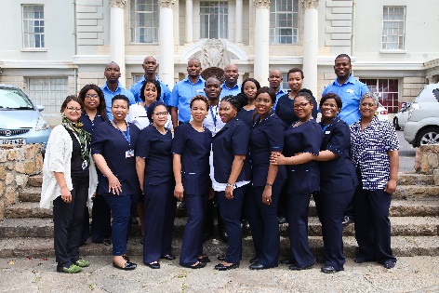
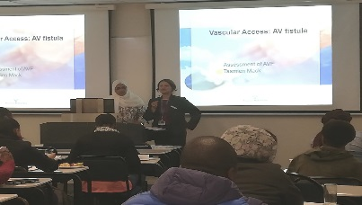
Division of Nursing & Midwifery
NEONATAL NURSING SEMINAR
The Neonatal Nursing Seminar was arranged and coordinated by Ms Hilary Barlow and Dr Nicki Fouche.
Hosted in the OMB Venue 2 and the E Floor skills lab Mother & Baby Sim room. The seminar responses for attendance had to be cut off at 60, as the demand for the course presented, had generated a response and demand beyond our expectation. The successfully hosted event included guest speakers:
Sr Hendrien Meyer from Safeline
Lance Howell from Groote Schuur Hospital
Ms Zarn Wortley from Christian Barnard Memorial Hospital
GENDER BASED VIOLENCE SYMPOSIUM
The Gender Based Violence in Context Symposium was arranged by Dr Tania de Villiers and hosted by UCT Nursing on 07 August 2018.
Attended by 40 delegates, speakers included:
Prof Loretta Feris Deputy VC Transformation UCT
Mrs Lizelle Africa Dept Director SOCA NPA
LT Col Tasswell Paulse Section Commander SAP GBV
The success of consecutive GBV Symposiums see’s the event being hosted by UCT annually
STAFF ACHIEVEMENTS:
DNM hosted a Mentorship & Leadership for Nurse Managers workshop, facilitated by Dr Nicki F
The workshop was very well attended by 40 Nurses from GSH Regional Hospitals
The Annual Nursing Road 2 Research day in collaboration with GSH, Nursing Education Dept and Red Cross War Memorial Children’s Hospital, was hosted at RXH. The popular event saw the Nursing Academics and Students collaborate this year.
Emeritus A/Prof Una Kyriacos presented a Vital Signs Workshop on 02 November 2018 facilitated in the E Floor skills lab. Attended by 25 people, and exceeding our expectations of 10 Attendees. Positive feedback was received.
A/Prof Kyriacos also presented an Ophthalmic Workshop on 09 November 2019
STUDENTS HEALTH & HUMAN RIGHTS OUTING
The PGDN diploma has a component of Health and Human Rights in the Professional Development Studies course.
The Division took the 53 student 2018 cohort to Iziko Slave Lodge and The District 6 Museum for a cultural and Human Rights outing. The feedback from the students was overwhelming, and the impact of the tours were evident to see.
NEPHROLOGY RENAL SYMPOSIUM
Renal Symposium arranged and coordinated by Sr Yolinda van der Nest and Sr Aletta Stubbs hosted on the 19 October 2018
A successive year of hosting the Renal Symposium, saw the event attended by 60 people.
Guest speakers included :
Dr S Sebastian, Dr Keith Weeder and Prof Charles Swanepoel.
The Renal Symposium is proving to be a popular, and another Nursing event to be hosted annually
Dr Nicki Fouche was a keynote speaker on “What happens behind the curtains?” at the World Nursing Congress hosted in Zurich
Dr Tania de Villiers attended the Nursing Network on Violence Against Women International Conference in Canada.

Slide 10


Postgraduate Committee
Graduation – December 2018
MSc Physiotherapy | Sara Warren Maxwell Limakatso Roche Crafford Sarah Cameron Faiza Achmat Fahmida Harris
MSc Exercise & Sports Physiotherapy/ MPhil Exercise & Sports Physiotherapy | Sarah Language Amy Burger Diana Kgokong Daniel Garnett
PhD Physiotherapy | Nuhu Assuman
PG Diploma Disability Studies | Ntungufhadzeni Mutele Justice Phukubje
MPhil Disability Studies | Marlene le Roux Jane Harrison Rachael Wanjagua
MSc Occupational Therapy | Jessica Ferguson Shanay Davidson Taryn Du Toit
PhD Occupational Therapy | Frank Kronenberg
MSc Nursing | Briony Berning Magret Haynes
MSc Speech-Language Pathology | Salma Higgs
MSc Audiology | Zenzo Chakara Mukovhe Phanguphangu
DQAC – Under Construction!
The current DHRS Doctoral Quality Assurance Committee process for PhD candidates is being revised. Watch this space for an exciting new format in 2019!

Slide 11


Research Committee
UPCOMING EVENTS
DHRS Writers Workshop
10-12 December 2018
FHS Undergraduate Research Day Prize Winners
Third prize oral presentation category | Jade Phillips, Kim Jones, Amanda Khumalo, Taryn Phillips, Tayla Wall | Doing Life with Social Media: Social Media and Young People's "Offline" Occupational Engagement (Mrs. Liesl Peters)
Third prize Poster category | Emma Dreyer, Michaela Coetzee, Siobhan Moore, Fezile Ntuti, Haley Box | The experiences of Community Rehabilitation Workers in facilitating participation of youth with disabilities in sport and recreation. (Ms Hanske Flieringa)
Second prize poster category | Gabriella De Souza, Maselimo Mokhomo, Clarissa Samuel, Shenel Singh, Thishala Waidyaratne, Gaboikangwe Kwaso" | The preferences and influencing factors of South African graduate audiologists’ orientation towards patient-centred care. (Ms Vera-Genevey Hlayisi, Mrs Christine Rogers)
Congratulations to Ms Anri Human (registered for PhD in Physiotherapy) and supervised by Prof Brenda Morrow and Prof Jennifer Jelsma who received first prize for her poster section on congenital/hereditary conditions at the International Congress on Neuromuscular Diseases (ICNMD 2018) in Vienna, Austria !

Slide 12
MID-DAY SEMINAR PRESENTATIONS
SPEAKER | TOPIC | PRESENTATION DATE
Dr Lieselotte Corten (Physio) - | “Characteristics, outcome and non-pharmacological management of children admitted with acute lower respiratory tract infections at Red Cross War Memorial Hospital." | 3 March 2018
Dr Brian Watermeyer (DSD) | “Disability, politics and loss; The psychological experience of contested identities” | 6 April 2018
Mrs Candice Hendricks (Physio) | “The characteristics, functional impact, physical activity levels and health related quality of life in women with chronic musculoskeletal disease and chronic diseases attending a local community health centre in Cape Town” | 24 August 2018
Dr Michal Harty (CSD) | “Implementing Autism Interventions in South Africa" | 14 September 2018
Professor Madie Duncan (OT) | “Participatory research: a strategy for disability inclusive development” | 5 October 2018
Professor Dele Amosun (Physio) | “National Development Plan: Strategies to Reduce Life Expectancy in South Africa” | 19 October 2018

